Slide 1
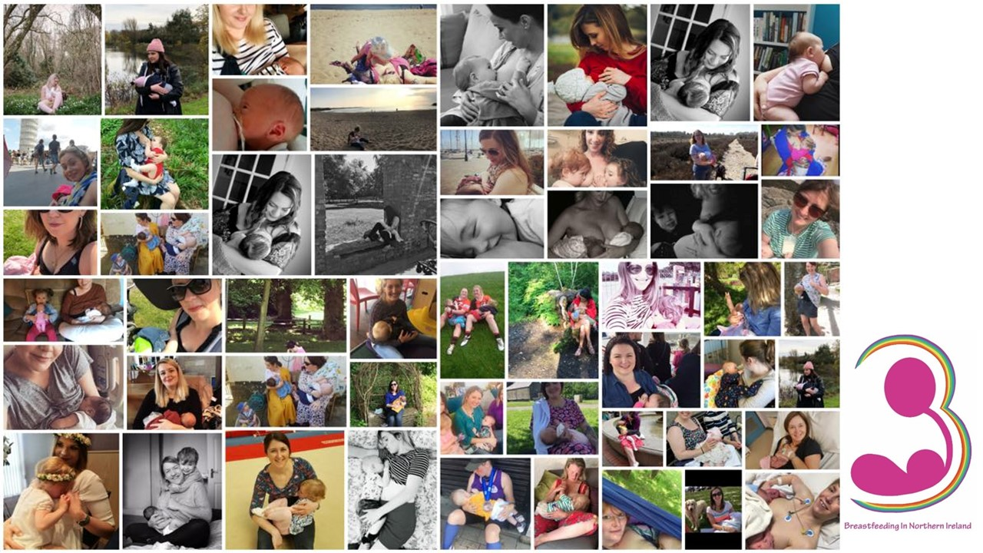

Slide 2
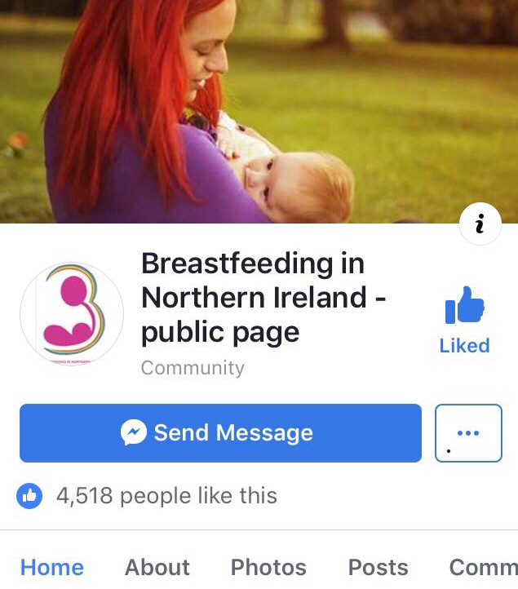
Our new public page
Started in January 2018
Purpose –
Normalize Breastfeeding – general public
Increase knowledge in woman’s real world (Dads, MIL’s and family tagged)
Allows sharing of information of how breastfeeding works
Currently 4,720 people following the page

Slide 3
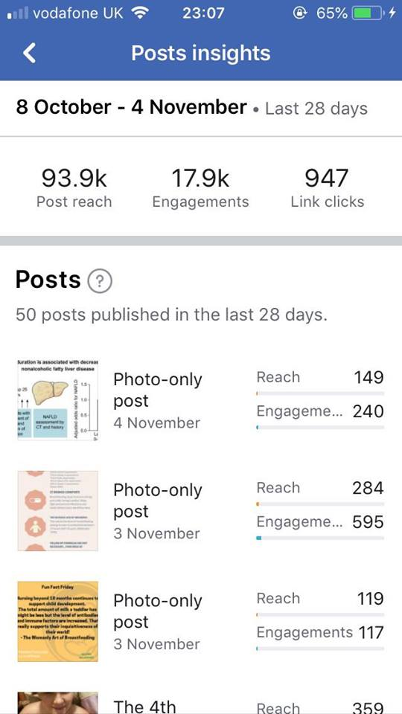
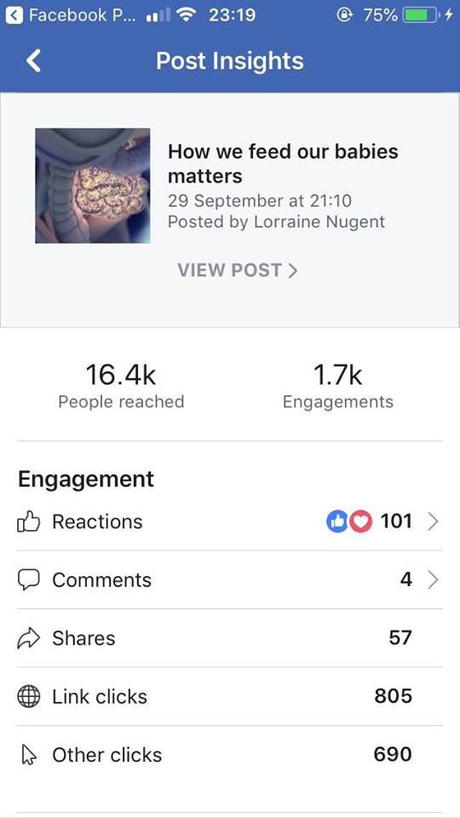
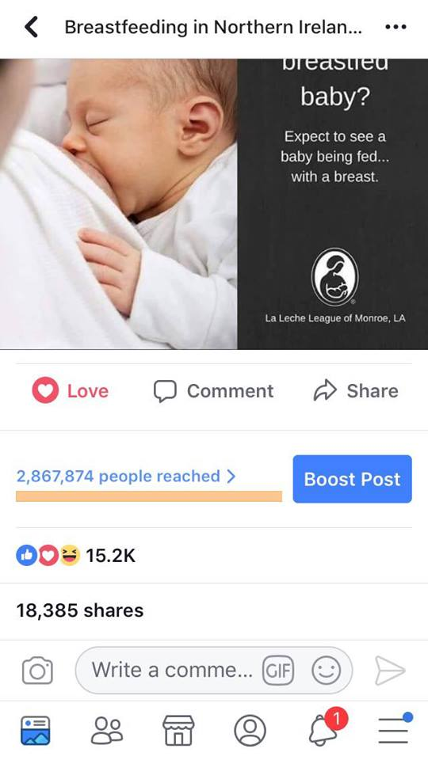

Slide 4
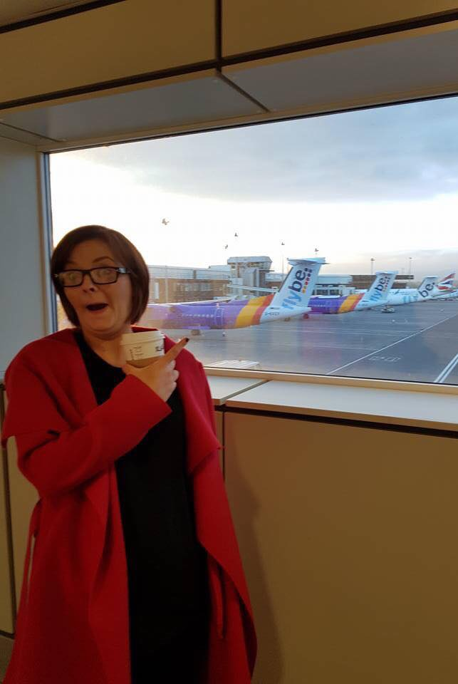
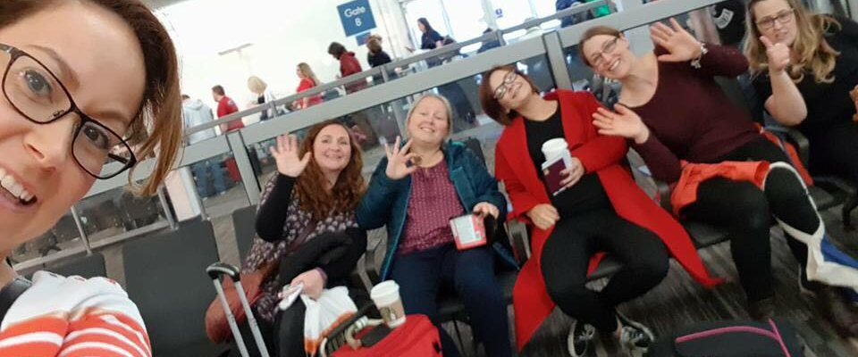
Off to the Mamma Awards!
Notes:
Largest Independent annual midwifery and maternity conference in the UK

Slide 5
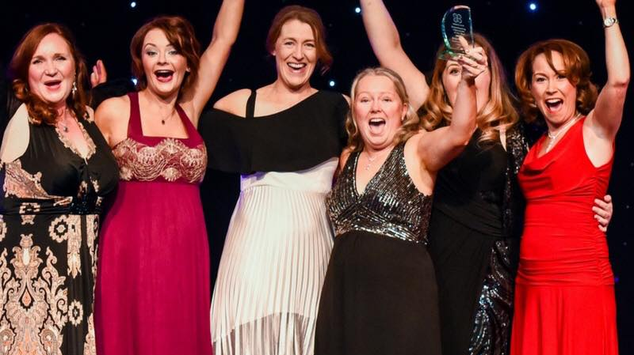
Breastfeeding Champions 2018!
Notes:
Said particularly impressed with the fact that we are all volunteers supporting women with no funding or involvement from statutory body
Also commented that we had “created a virtual village for women, especially helpful in the “wee small hours”

Slide 6
Positive Birth NI Awards BFNI and Mammæ are shortlisted!
Mammæ Carol Smyth IBCLC Wins !!

Slide 7
Links with Wendy Jones

Slide 8
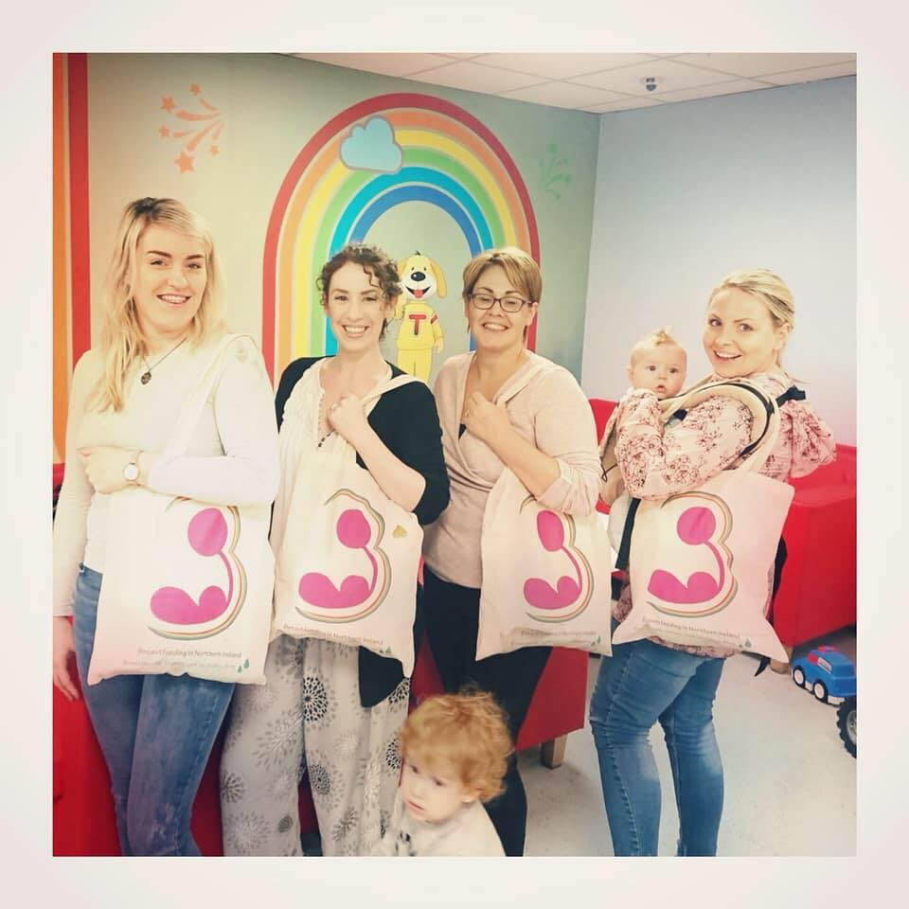
Real life connections

Slide 9
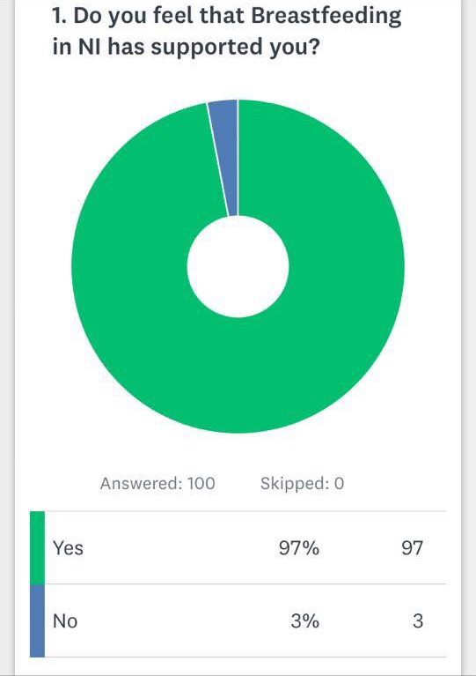
SurveyMonkey Oct 2018

Slide 10
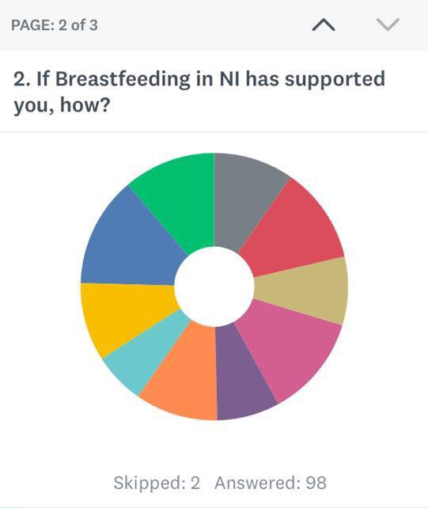
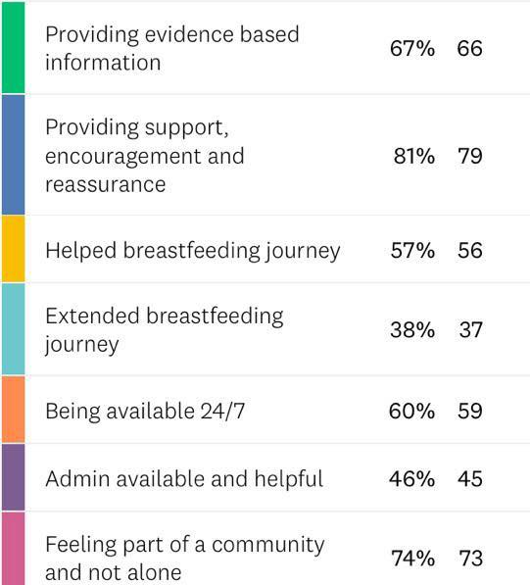

Slide 11
Suggestions for improvement
meet ups for mums - isolation
Provide more “visual information”
Daily information post

Slide 12
Snapshot of BFNI
28 days - 56,670 posts
7 days -263 posts with 3,405 comments and 9,382 reactions
Approx. 38 posts per day receiving 13 comments each
6,364 active members that week out of the total 8,700 (1,500 since 2017) in the group
So 74% of our overall membership engaged with each other in that week alone
In that week we received 80 new member requests, at least 11 per day. We approved 51% of requests

Slide 13
24 Hours in BFNI 20/10/18
37 posts
358 comments
682 reactions
16 requests for breastfeeding help –
all answered by an Admin
4 information posts from Admin
8 posts celebrating their breastfeeding journey

Slide 14
24 hours in BFNI
00:51 1 day old – what’s normal?
01:20 cluster feeding, 3 Days old
02:52 Engorgement at 9 weeks
05:59 Comebacks for co-sleepers
07:28 2 year old night feeds – normal?
08:23 looking back – 1year after weaning
09:34 Is my 4 week old feeding well?
09:46 Golden Boobies - celebration
09:49 Bottle refusal 4mths, how will I do exam?
11:06 Admin post: Breast Crawl video
11:10 Admin post: Global Health media video
12:58 Donation – Breastmilk storage bags
13:38 Partner got Breastmilk keepsake art - Birthday
13:52 Baby has a cold, should I keep feeding him?
14:04 Can I keep feeding when I have food poisoning?
14:35 Breastfeeding puts my 17 month old to sleep every time!
14:47 Biting help - late onset low milk supply
15:22 Breastfeeding at Rosepark Farm - owner congratulated me
15:37 NIP (nursed in public) at Giants Causeway

Slide 15
24 hours in BFNI
16:18 NIP at Belfast Castle
17:11 Pump recommendations?
17:18 3 week old poor weight gain - what is switch nursing?
17:38 Return to work help
18:08 Nursing strike is over, thank you for your help
18:36 4 month sleep regression help
18:55 Admin Post - La Leche League Meeting info
19:23 My baby tried to latch to a pumpkin
19:33 3 day old baby, should I have a routine?
20:18 2year old is sick and only wants breastmilk
20:36 Family want me to give a dummy, I don’t
20:41 Admin post – It’s ok to wake a sleeping baby to offer a feed
21:50 “The Let Down” comedy on Netflix
22:48 15 week old, how much milk should he get?
23:01 Breastfeeding on TV “With this Ring”
23:22 Low milk supply in one breast after mastitis.
23:58 Feeding my sick baby in SWAH

Slide 16
Notes:
Just over a quarter of members have fed beyond 6mths

Slide 17
Experiences of mothers in BFNI

Slide 18
BFNI supporting Research
PhD student Sharon Guille – nipple pain
Prof Marlene Sinclair – Traumatic memories of breastfeeding
Prof Marlene Sinclair & Dr Julie McCullagh – ConnectEpeople
Dr Maria Herron – Use of online collective intelligence to develop real life breastfeeding support

