Slide 1
Breastfeeding on the island of Ireland
Dr Joanna Purdy
Dr Helen McAvoy
Dr Noelle Cotter
Institute of Public Health in Ireland
1

Slide 2
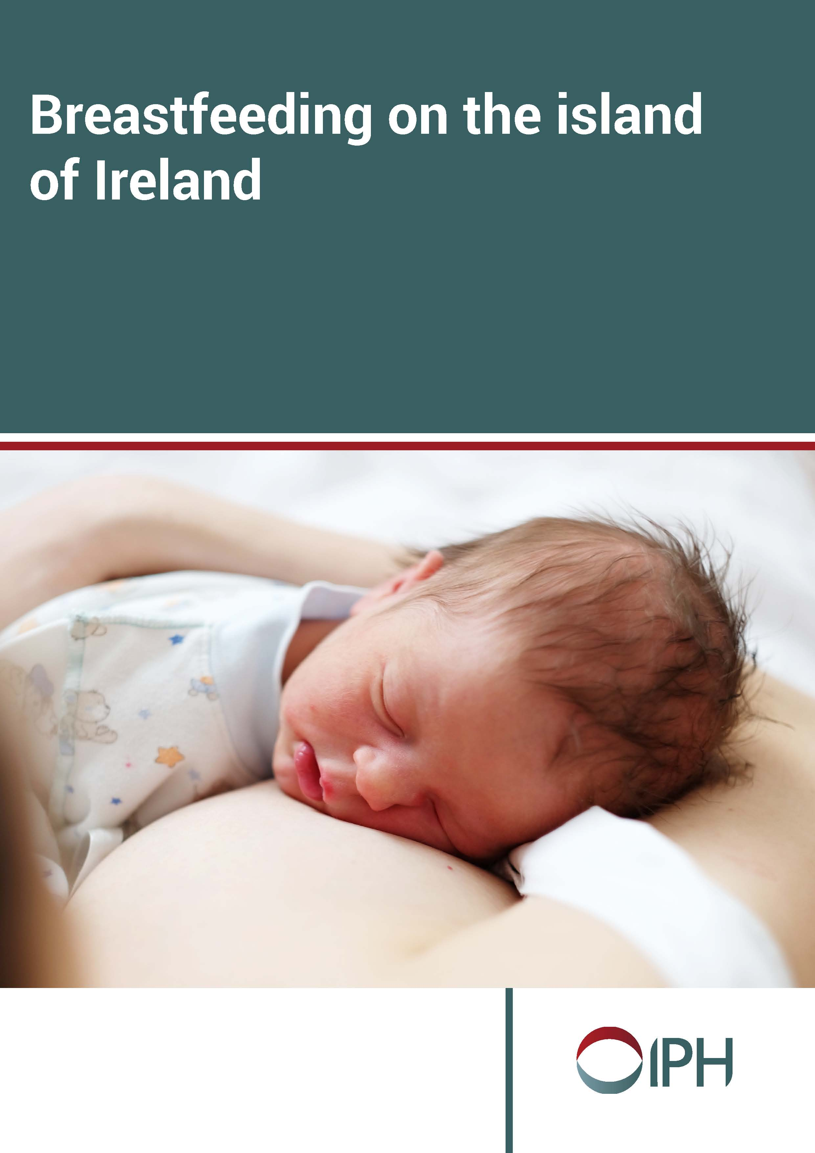
Presentation overview
Policy context
Data sources
Starting to breastfeed
Breastfeeding prevalence over time
Breastfeeding experiences
Attitudes to and perceptions of breastfeeding
2

Slide 3
Policy context – Republic of Ireland
3

Slide 4
Policy context – Northern Ireland
4

Slide 5
Breastfeeding data sources
Republic of Ireland | Northern Ireland
Health Service Executive Key Performance Indicator Metadata (2016) | Northern Ireland Maternity System (2016)
National Perinatal Reporting System (2015) | Northern Ireland Child Health System (2014/15)
Growing Up in Ireland Survey (2015; Infants born in 2008) | UK Infant Feeding Survey (2010)
National Infant Feeding Survey (2008)
Childhood Obesity Surveillance Initiative (2012; Infants born around 2005)
5

Slide 6
Data sources on attitudes, perceptions and experiences of breastfeeding
Republic of Ireland | Northern Ireland
Growing Up in Ireland Survey (2015; Infants born in 2008) | Health Survey Northern Ireland (2012/13 & 2013/14)
National Infant Feeding Survey (2008) | UK Infant Feeding Survey (2010)
 | Young Person’s Behaviour and Attitudes Survey (2016)
 | PHA commissioned research (2016)
6

Slide 7
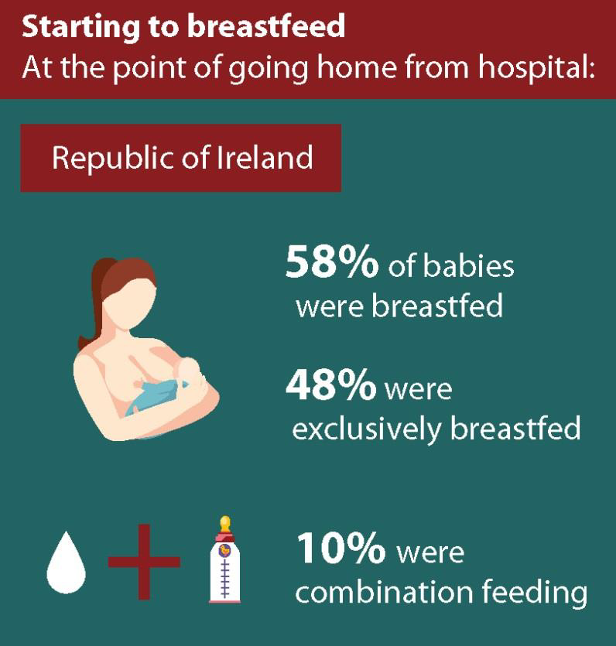
Starting to breastfeed
7

Slide 8
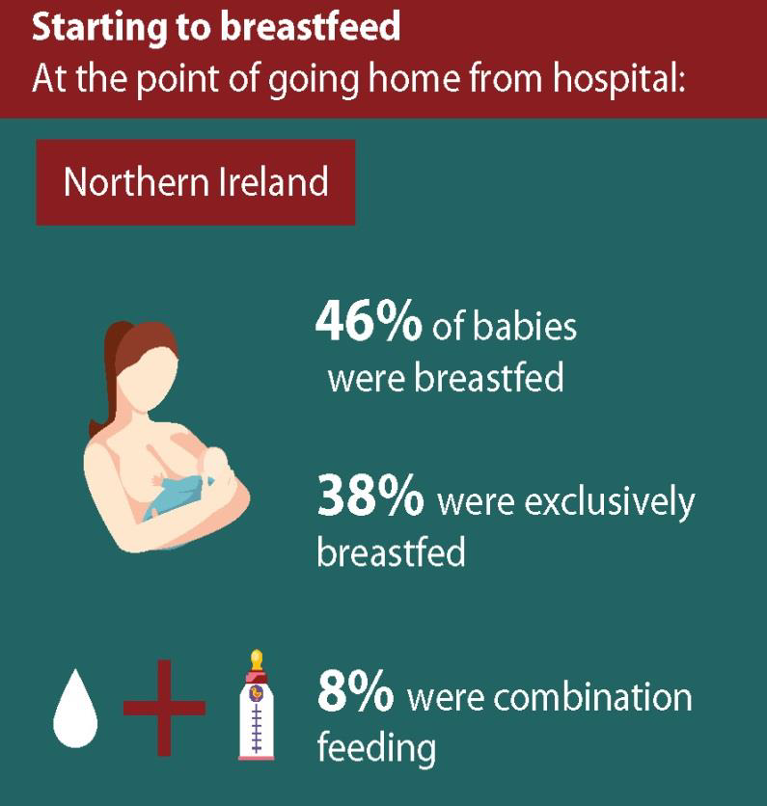
Starting to breastfeed
8

Slide 9
Breastfeeding rates on discharge from hospital from 2006-2015
9

Slide 10
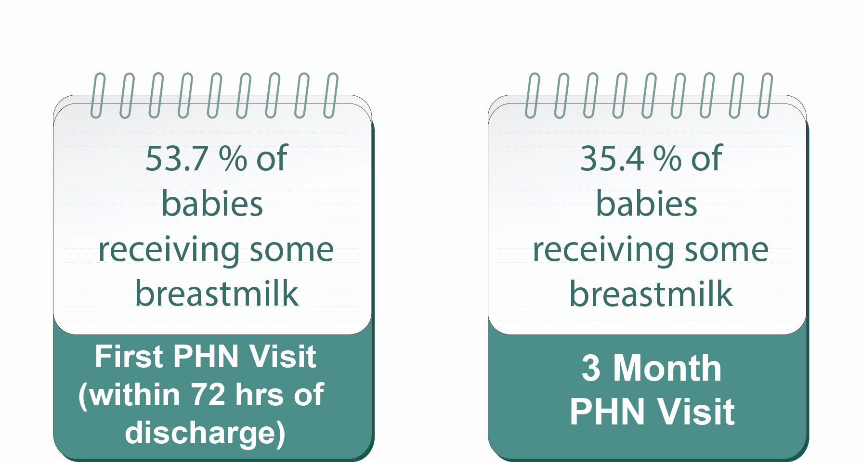
Breastfeeding prevalence in first year of life
10

Slide 11
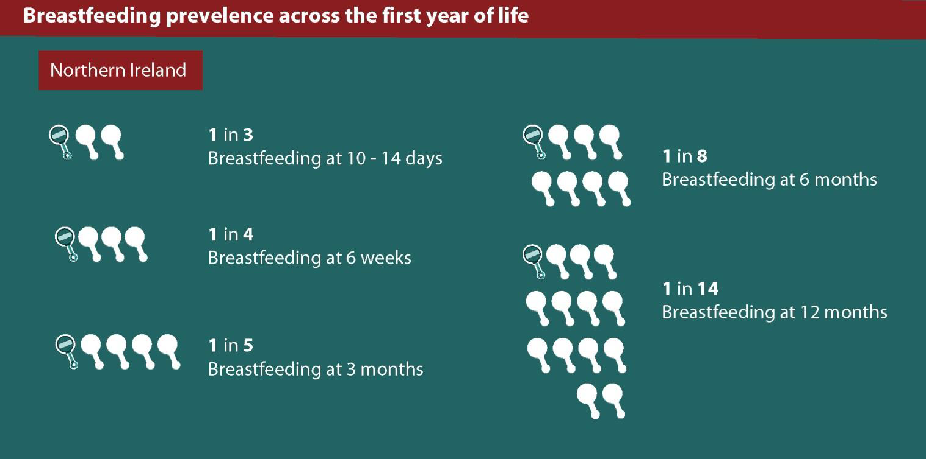
Breastfeeding prevalence in first year of life
11

Slide 12
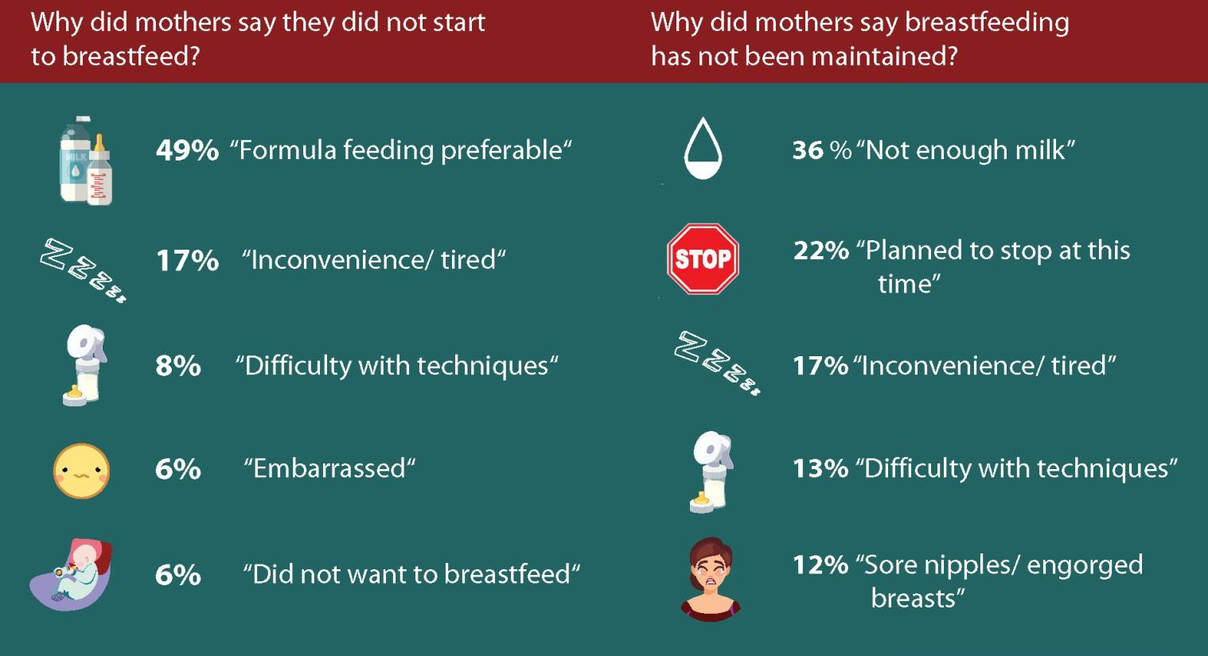
Breastfeeding experiences – Republic of Ireland
12

Slide 13
Breastfeeding experiences – Northern Ireland
13

Slide 14
Attitudes to and perceptions of breastfeeding in the Republic of Ireland
% adults (aged 15+) agreeing with the following statements: | 2017
Women have the right to breastfeed in public places | 85%
I am comfortable when mothers breastfeed their babies near me in a public place | 81%
A mother needs a lot of support to breastfeed her baby | 80%
14

Slide 15
Attitudes to and perceptions of breastfeeding in Northern Ireland
Proportion of respondents (aged 16+) who ‘agreed’ or ‘strongly agreed’ that… | 2012/13 | 2013/14
Breastfeeding is normal | 89% | 92%
Breastfeeding is good for baby | 85% | 90%
Breastfeeding is embarrassing | 17% | 13%
Breastfeeding is distasteful | 4% | 4%
Breastfeeding is offensive | 3% | 4%
15

Slide 16
Final observations
Breastfeeding rates across the island of Ireland have increased slowly over the last decade
Younger mothers and those living with socio-economic disadvantage were less likely to breastfeed in both jurisdictions
Data from NI suggests that public attitudes to and perceptions of breastfeeding are improving
Creating a supportive breastfeeding environment is a shared challenge and is the focus of the strategic driection across the island.
16

Slide 17
Thank you
Any questions?
Report: Breastfeeding on the island of Ireland
Email : joanna.purdy@publichealth.ie
Web: www.publichealth.ie
www.twitter.com/publichealthie
17

