Slide 1
Breastfeeding Research Workstrand & Research Funding Ulster University, 9 November 2018
Dr Nicola Armstrong
Programme Manager
HSC R&D Division, PHA

Slide 2
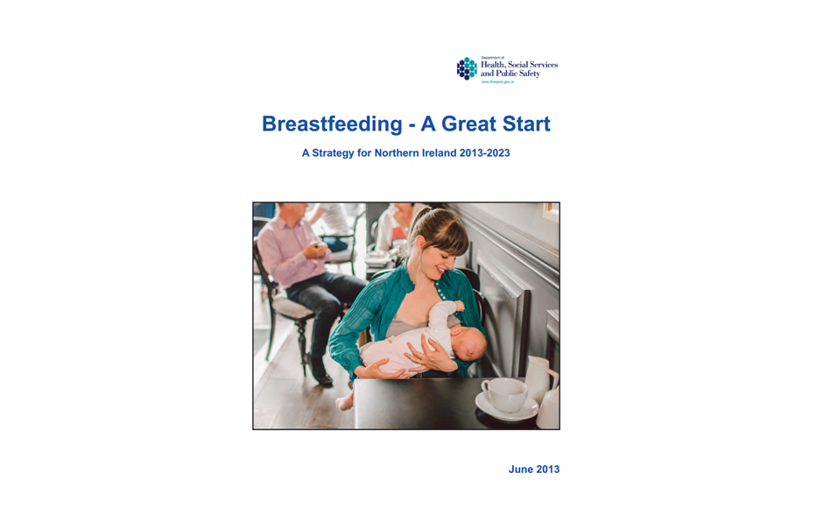
Breastfeeding Strategy NI
The purpose of the Strategy is to improve the health and well-being of mothers and babies in NI through breastfeeding
It sets out the strategic direction to protect, promote, support and normalise breastfeeding in NI

Slide 3
BSISG
Chair:
Dr Carolyn Harper, Director of Public Health, PHA
PHA
Tinylife
HSCTs
Early Years
La Leche League
Education
DoH
Sure Start
TAMBA

Slide 4
BSISG
Workstrand | Chair
1 - Legislation Workstrand | Gerard Collins
2– Workplace Support | Janet Calvert
3– HSC & Community Support | Denise Boulter
4 – Neonatal | Janet Calvert & Heather Reid
5 – Baby Friendly Settings | Janet Calvert
6– Professional training & Development | Carolyn Moorhead
7– Public Information | Stephen Wilson & Chris Barnes
8 – Monitoring and indicators | Julie Neill
9– User Involvement | Janet Calvert
10 – Research | Nicola Armstrong

Slide 5
Research Workstrand
Outcome 1 – Supportive environments
Outcome 2 – HSC knowledge & skills
Outcome 3 - High quality information systems
Outcome 4 – Informed & supportive public

Slide 6
Research Workstrand
Action 1
Review research evidence & information on effective practice in relation to breastfeeding, on an on-going basis and advise BSISG accordingly
Action 2
Work with the NI Public Health Research Network to foster local research to understand what works in increasing breastfeeding rates
Action 3
To explore partnership opportunities to increase research capacity within NI

Slide 7
Research Funding
Government funding
HSC R&D Division
National Institutes for Health Research (NIHR)
UK Research & Innovation (UKRI)
Charitable Organisations
The Health Foundation
Wellbeing of Women
Professional Bodies
Royal College of Midwives (RCM)

Slide 8
Highlights: UKRI
UK Research and Innovation is a new body which works in partnership with universities, research organisations, businesses, charities, and government to create the best possible environment for research and innovation to flourish.
Operating across the whole of the UK with a combined budget of more than £6 billion, UK Research and Innovation brings together the seven Research Councils, Innovate UK and a new organisation, Research England. Research covers the full spectrum of academic disciplines from the medical and biological sciences to astronomy, physics, chemistry and engineering, social sciences, economics, environmental sciences and the arts and humanities.

Slide 9
Highlights: The Health Foundation (HF)
The Health Foundation is an independent charity committed to bringing about better health and health care for people in the UK.
Second largest endowed foundation in the UK focusing on health, they spend around £30 million a year on improving health and health care.
Aim is a healthier population, supported by high quality health care that can be equitably accessed. The HF aims to learn what works to make people’s lives healthier and improve the health care system.
By giving grants to those working at the front line to carrying out research and policy analysis, it shines a light on how to make successful change happen.

Slide 10
Example: Successful Research Project
Partners in Birth : empowering women to achieve physiological birth and reduce interventions
Commenced September 2017 for 15 months
Barking, Havering & Redbridge University Hospitals NHS Trust, in partnership with Maternity Voices Partnership Queen’s, a multidisciplinary service user group.
Aiming to increase breastfeeding rates, and reduce unnecessary obstetric interventions.
Delivering a pioneering programme of antenatal education to 200 women and their birth partners in primary care settings.
Aims to educate and motivate expectant parents to be informed and become active participants in the birth process.
Average class size of 10 couples. For women who are 32–34 weeks pregnant – believed to be the optimum time to impact their decisions around labour and birth.
Gill Perks, Consultant Midwife, Queens Birth Centre, Romford, gillian.perks@bhrhospitals.nhs.uk

Slide 11
Highlights: Wellbeing of Women (WoW)
Wellbeing of Women is the only charity in the UK funding peer-reviewed pioneering research across the whole spectrum of women’s reproductive and gynaecological health. Since the charity was established in 1964, they have invested around £54 million.
Wellbeing of Women’s grant award programme seeks to improve the health of women and babies by:
Supporting high-quality research
Addressing gaps in knowledge
Investing in the training of new researchers with promising potential
Meeting an identified need to improve the health of women
Ensuring the long-term future of the charity by maintaining a reputation for quality and transparency

Slide 12
Example 1: Entry-level Scholarships (ELS) Midwives
These awards are supported by:
Last submission deadline was 20 September 2018
Applications for training in research in one of the following areas:
Pregnancy, birth and the postpartum period
General wellbeing surrounding women’s health issues
Scholarships are a maximum of £20,000 and are awarded for up to one year to contribute to salary and/or research costs.
The aim of these awards is to provide ‘pump-priming’ funds to enable candidates to be exposed to a research environment, or to obtain pilot data for bids for definitive funding.

Slide 13
ELS Midwives Success Rates
Year Applications Awarded Success Rate (%)
2015 5 2 40%
2016 4 1 25%
2017 – – –
2018 8 1 12.5%
*no midwife applications were received in 2017

Slide 14
Example 2: Research Project Grants
Next Research Project Grants round will open in November 2018
These awards provide funding for research projects up to three years. The upper limit of this award is £200,000. The research must be carried out in the UK or Ireland.
Projects can include research in the areas of Pregnancy, Birth and the postpartum period; General wellbeing surrounding women’s health issues; and Gynaecological cancers.
The application form and guidelines will be made available on call launch. If you have any queries, please contact Jeremy Barratt on jbarratt@wellbeingofwomen.org.uk or 0203 697 6350.

Slide 15
Research Project Success Rates
Year | Applications | Awarded | Success Rate (%)
2015 | 58 | 3 | 5.2%
2016 | 59 | 4 | 6.8%
2017 | 42 | 3 | 7.1%
2018 | 74 | tbc | tbc

