Slide 1
Valuing Breastfeeding in the UK
£x?
Clare Relton
Friday 9th November 2018
Belfast, NI
Notes:
950am – 45 mins -
99 BFN breastfeeding support volunteers 20 HCPs - doctors, doulahs lactation consultants 24 other volunteer peer support workers 31 speakers, presenters
Talk about their role in NOSH

Slide 2
Outline
The NOSH Project
What we know now
What next
Your views

Slide 3
UK breastfeeding rates
Major public health challenge
‘Emergent property’ of multiple complex interacting systems – food, social, health, employment, taxation, legal
Multiple actors & perspectives
Research needed to identify interventions to contribute to reshaping this complex system in a positive way
Notes:
Complex systems – outcomes of a multitude of interdependent elements within a connected whole. These elements affect each in sometimes subtle ways with changes potentially reverbaerating throughout the system. A complex systems approach uses a broad spectrum of methods to design implement and evaluate interventions for changing these systems to improve public health.
Complex systems are defined by several properties including emergence, feedback and adaptation
The low BF rates in the UK can be conceptualised as an emergent property of the food, employment, transport, economic and other systems that shape the way we feed our infants.

Slide 4
The beginning
Notes:
Started off in obesity research….. Looking for interventions to improve obesity levels

Slide 5
Soft drinks industry levy
£s to create positive change in obesity system
Aim to prompt industry to reformulate sugar content
Trigger multiple reactions by stakeholders (positively impact on diet and health)
Notes:
How to evaluate soft drinks industry levy.
https://www.thelancet.com/journals/lancet/article/PIIS0140-6736(17)31267-9/fulltext
Concept mapping workshop – initial system map (representation from academia, PH profs, govt, civil society & industry)
Data sources identified to allow measurement of effects across a range of domains using ITS analyses, including price, formulation, purchases, consumption, preferences, diet and health.
Qualitative enquiry, incl analysis of public media, and professional discourses to further illuminate reported changes.
Triangulation between data sources to create a consistent interpretation and conclusions about the impacts of the soft drinks industry levy, thus strengthening causal inferences.
Harry Rutter et al, Lancet 2017

Slide 6
The beginning
Notes:
What is the first meal?
Social patterning by SEC and SEP (socio-economic positioning)
“I feed my baby normal milk”
“Mothers should breastfeed”

Slide 7
July 2013 - Duchess of Cambridge decides to BF
We know…..
Notes:
The nations knowledge
The apparent decision by the Duchess of Cambridge to breastfeed has been given a boost by fresh evidence showing it can help raise a baby’s IQ

Slide 8
Infant formula industry levy?
Notes:
What is the first meal?
Social patterning by SEC and SEP (socio-economic positioning)
“I feed my baby normal milk”
“Mothers should breastfeed”

Slide 9
Notes:
What is the first meal?
Social patterning by SEC and SEP (socio-economic positioning)
“I feed my baby normal milk”
“Mothers should breastfeed”

Slide 10
Money & breastfeeding in the UK
£16.4mn spent annually promoting follow-on formula
£25 per baby
Government program (Healthy Start) £83mn p.a.
x? on vouchers for free infant formula
Public Health England spends £300,000
38p per baby
Notes:
4mn babies born in the USA annually
Despite these individual and system-wide costs, lactation support is inadequately prioritized by policy makers and health practitioners
UK Law prohibits advertising and promotion of infant formula marketed for use from birth. However, follow-on formula (marketed for use from 6 months of age) can be advertised and promoted
Public Health England spends £300,000
38p per baby
Breastfeeding celebration week, Breastfeeding Friend facebook chatbot, Becoming Baby Friendly project, Start4life

Slide 11
UK research
NOSH Project (2012-2017)
Notes:
Delighted to present on behalf of this collaboration – talented researchers – public health, health economics, trials, qualitative methods, infant feeding – working closely with practitioners and women
Tackling one of the most important challenges in public health – endemically low breastfeeding rates in some communities, and the substantial societal barriers that have developed as a result

Slide 12
The plan
Series of studies to design and test cash transfer scheme in areas with low breastfeeding rates (synergizing with existing BF support/resources)
Focus on any breastmilk at 6-8 weeks
Year 1 – development
Year 2 – feasibility test
Years 3-4 – full scale randomised trial
Notes:
Importance of adding something too what is already ongoing (not replacing the role of HVs, MWs, BFSWs Baby Buddy etc)

Slide 13
Concerns
“Is it ethical to use that hook?” (Local Authority)
“You can give mums something to encourage them to breastfeed but she still might be getting hassle off family members, friends and things like that” (5, BFPSW)
“They should do this because they want to do it not because someone’s saying well we’ll give you 50 quid for doing it” (19, Health Visitor)
Notes:
Reservations about scheme in principle

Slide 14
Hopes
“without trying to delve into the ethical debate and getting all middle class about it, if it does what it sets out to achieve, then that is a good thing, because the knock-on benefits to the rest of the, you know, in terms of population could be big” (23, Midwife)
“For the ones who are umming and awing about it, it might work” (FG2, Midwife)
Notes:
Positive views of scheme

Slide 15
Local street intercept survey n= 128 women
More acceptable in areas with low rates
Notes:
Women living in low BF neighbourhoods find the NOSH scheme more acceptable than those women living in neighbourhoods with high BF rates
Results
- 80% thought it was a good idea
Methods
Talked to women – street intercept survey at shopping centres in Crystal Peaks/Castle Market/Barker’s Pool
Women aged 16 yrs +
54/128 were from neighbourhoods with low 6-8 wk breastfeeding rates
Manor, Arbourthorne, Page Hall, Darnall, Mosborough, Shiregreen, Upperthorpe, Handsworth,

Slide 17
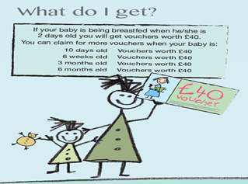

Slide 18
The why
“The NOSH Scheme offers vouchers to mums who breastfeed as a way of acknowledging both the value of breastfeeding to babies, mums and society, and the effort involved in breastfeeding"

Slide 19
Vanessa

Slide 20
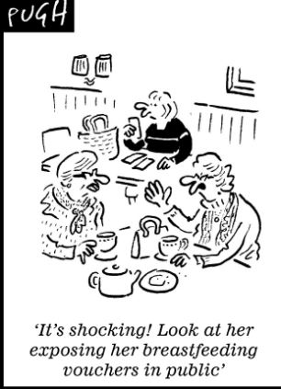
The media reaction
Field testing the scheme
Nov 2013

Slide 21
Trial results
10,010 babies due 6-8 week developmental check
5,398 eligible infant-mother dyads
2,496 (46%) registered with the scheme
2,179 (40%) claimed vouchers
1,827 (34%) claimed 6-8 week vouchers

Slide 22
The trial results
Primary outcome – mean cluster level 6-8 weeks breastfeeding 32% control vs 38% intervention
6% point increase in breastfeeding
Increased over time 3%point (Q1) $−$ 10% point (Q4)
Small (non-significant) increases in initiation and exclusive breastfeeding at 6-8wks
Notes:
6% point difference in favour of the intervention (95% CI, 2.4.-10.0; P = 0.002)

Slide 24
Voucher claims
96% (8,239) countersigned by midwives or health visitors
Other signatories: nurses, GPs, paediatricians, nursery nurses, breastfeeding support workers and midwife support workers
528 signatories in total

Slide 26
Offering £s for breastfeeding
Engaged people
Impacted on relationships
Helped communicate the value of breastfeeding
Positive influence on those who support and protect women who breastfeed
Notes:
Engaged people – everyone can talk about BF
Men talking about it down the pub
MWs found it easier to talk to women living in non BF cultures
Media/ social media discussions about BF

Slide 28
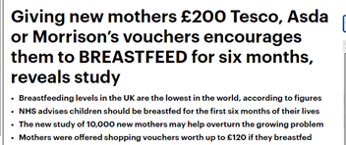
The response
Notes:
http://www.bbc.co.uk/news/health-42280444
Lots of reactions

Slide 29
Fiona
Notes:
https://www.bbc.co.uk/news/av/health-42324534/shop-vouchers-could-boost-breastfeeding

Slide 30
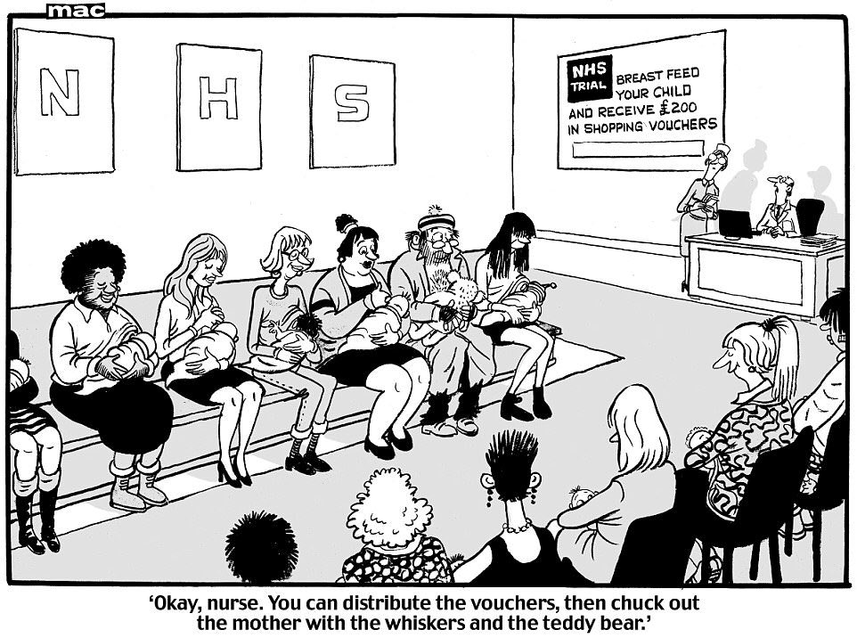
November 2017 - Trial results announced

Slide 31
Changing the conversation
2013
2017
Notes:
Changing the nations conversation…..

Slide 32
USA research
Puerto Rican women
Low income
WIC programme
Breastfeeding
Financial incentives
Monthly
Increasing $20 to $70 ($270 total)
Contingent on observed breastfeeding
Yukiko Washio, Pediatrics. 2017
Notes:
http://pediatrics.aappublications.org/content/early/2017/02/02/peds.2016-3119
Washio Y, Humphreys M, Colchado E, et al. Incentive-based Intervention to Maintain Breastfeeding Among Low-income Puerto Rican Mothers. Pediatrics. 2017;139(3):e20163119
Dr. Yukiko Washio, the Principal Investigator (PI), is faculty at the Department of Behavioral Health and Nutrition at University of Delaware and at the Obstetrics and Gynecology Department of Christiana Care Health Services (CCHS).

Slide 33
USA research
Individual recruitment
N=36 recruited
Notes:
http://pediatrics.aappublications.org/content/early/2017/02/02/peds.2016-3119
Washio Y, Humphreys M, Colchado E, et al. Incentive-based Intervention to Maintain Breastfeeding Among Low-income Puerto Rican Mothers. Pediatrics. 2017;139(3):e20163119

Slide 34
Results

Slide 35
Financial incentives for breastfeeding
USA
Maintaining breastfeeding RCT with low income mothers on WIC programme (Pediatrics, 2017)
NIH full trial (2019-2023)

Slide 36
Financial incentives for breastfeeding
UK
NOSH Trial (JAMA 2017)
Barnsley Family Nurse Partnership (Journal of Health Visiting 2017)

Slide 37
Notes:
https://www.magonlinelibrary.com/doi/10.12968/johv.2017.5.12.606

Slide 38
“Its obvious that its cost effective but there is no political traction ….x thinks people should not be paid to do what they should already be doing”
Director of Public Health
Notes:
DPH

Slide 39
Four forms of social support
Instrumental support (enabling/ empowering nature of money to obtain resources required to breastfeed)
Informational support (the scheme booklet providing information about the value of breastfeeding and where to seek support to breastfeed),
Emotional support (women felt valued by the vouchers and the 'congratulation' letters accompanying them)
Appraisal support (offering the vouchers at different time points helped women set breastfeeding )
Theory of social support (House, 1981)

Slide 41
What next?
Notes:
A tangle of questions
In no particular order – each question links to each of the others
Objective assessment of breastfeeding
Long term impact
Exclusive (not any) breastfeeding
How to make it ‘policyable’? – translating into policy and practice – what is the most efficient (effective and economic) formula/ recipe –
which populations (sub-analyses – by routine data – bF initiation, BF at 6-8 wks – randomise or stratify by service e.g. neonatal unit, HV service, MW service, Young mums service)
How integrated/embedded with which services (ensuring that it complements/ synergises with existing provision)
How integrated/ combined with existing PH social media based interventions (given the need to inform and support over and above the many hundreds of days when women are not in contact with their midwives or health visitors
which formulas/ recipes of the intervention – conditionality, amount, timing, single vs multiple doses
Funding the vouchers?
Best way to test (area based routine data vs service delivery based data)

Slide 42
The plan - Valuing Breastfeeding
5 year research programme
England, Scotland, Northern Ireland
Notes:
Importance of adding something too what is already ongoing (not replacing the role of HVs, MWs, BFSWs Baby Buddy etc)

Slide 43
Goals
To identify an optimally targeted and cost-effective financial incentive scheme to increase breastfeeding across the UK
Study the impact of financial incentives for breastfeeding on multiple levels within the UK Infant Feeding complex system
Inform UK decision makers about a range of financial incentive policy options

Slide 44
Year 1
Work with a wide range of stakeholders in infant feeding to develop the different financial incentive based intervention and refine the research design.

Slide 45
Years 2 - 5
The trial – multi-arm, multi-stage trial
Simultaneous and efficient testing of multiple (different sized) financial incentives over three years
Stop those that are less effective
Continue the most promising ones
Stratify by population level breastfeeding rates at 6-8 weeks

Slide 53
The research plan
Field test newly developed objective markers of breastfeeding (for use with the vouchers)
Notes:
• To assess the effectiveness, acceptability and generalisability of a range of values of financial incentives
• To assess the longer-term health outcomes for infants and mothers in the different intervention areas
• To assess the longer-term cost effectiveness of the approaches tested
• To determine the level of any misreporting of breastfeeding in routine administrative data on infant feeding

Slide 54
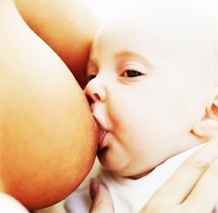
Macromolecules in Human Milk
[g/L]
Protein
12
35
Fat
35
35
Lactose
65
45
Oligosaccharides
5-15
0.05
Slides courtesy of Lars Bode

Slide 55
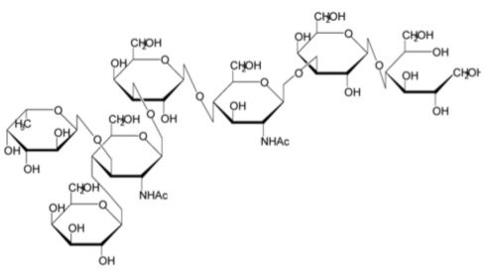
Human Milk Oligosaccharides (HMOs) are Complex Sugars
N-acetyl-glucosamine (GlcNAc)
Fucose (Fuc)
Glucose (Glc)
N-acetylneuraminic acid
(Neu5Ac) sialic acid
Galactose (Gal)

Slide 56
Personalized complex HMO composition
(HMO ”fingerprint”)
Relative HMO composition (% of total HMOs)
n=1,206
preliminary data from CHILD study cohort
(in collaboration with Dr. Meghan Azad)

Slide 57
Incentives
Who?
Conditional on?
How much?
What for?

Slide 58
Size of incentive
Scale down?
Nudge theory based on 5p every time a mother puts her baby to the breast
If she does this 20 times a day = £1 a day x 7 days = £7 a week x 6-8 weeks = £42 - £56 at 6-8 weeks
Notes:
5p tax on single use plastic bag was introduced in October 2015 and within 6 months reduced plastic bag use by 85% - its now up to 90%
So using nudge theory based on 5p everytime a mother puts her baby to the breast
If she does this 20 times a day = £1 a day x 7 days = £7 a week x 6-8 weeks = £42 - £56 at 6-8 weeks
So £50 one payment at 6-8 weeks for either any or exclusive BF?
Plastic bag 5p tax goes to charity
So how about 5p tax on every tin of infant formula – and that is used to pay for the BF incentive…
2015-2025 an estimated £730 million generated from retailers charitable donations. Where does this money go? Is it going to PHE?

Slide 59
Type of incentive

Slide 60
Restricted?

Slide 61
Most likely variations…?
1. Same value voucher (£40) conditional on any breastmilk at 3 timepoints (2 days, 10 days, 6-8 weeks)
2. Lower value voucher (£20) conditional on any breastmilk at 3 timepoints (2 days, 10 days, 6-8 weeks).
3. Single voucher (£100) conditional on exclusive breastmilk at 6-8 weeks

Slide 62
NOSH
• Value of the voucher (£40) conditional on any breastmilk at 5 timepoints (2 days, 10 days, 6-8 weeks, 3 months and 6 months)
• The experimental interventions will be offered in the intervention clusters for between one to three yrs

Slide 63
November 2017 - Trial results announced

Slide 64
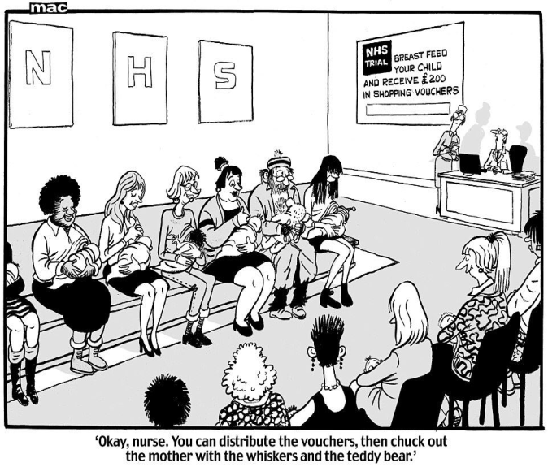
Valuing Breastfeeding
Thank you
Questions?
c.relton@sheffield.ac.uk
Notes:
950am – 45 mins -
99 BFN breastfeeding support volunteers 20 HCPs - doctors, doulahs lactation consultants 24 other volunteer peer support workers 31 speakers, presenters
Talk about their role in NOSH

Slide 65
Slides courtesy of Lars Bode

Slide 66
SPARE SLIDES

Slide 67
Measuring outcomes
Multiple sources & perspectives
Trial
Primary outcome
Any breastfeeding at 6-8 weeks
Secondary outcomes
1. Initiation of breastfeeding
2. Exclusive breastfeeding at 6-8 weeks
3. Breastfeeding at hospital discharge, 7 – 10 days, 10-14 days, 6 and 12 months
4. Cost-effectiveness of the approaches tested

Slide 68
5 million years of product development
Vouchers for Breastfeeding

Slide 69
Public impact
Legitimacy
Public confidence
Stakeholder engagement
Political commitment
Policy
Clear objectives
Strong evidence
Feasibility
Action
Management
Measurement
Alignment
Notes:
Source – Centre for public impact – global organisation
Legitimacy – underlying support for any initiative is influenced by
Public confidence
Stakeholder engagement
Political commitment
Policy – a good policy needs to have
Clear objectives
Strong evidence
Feasibility
Action –translating policy into real world action – this needs
Management
Measurement
Alignment

Slide 70
Incentives
Who?
Mother
Mother plus a ‘Significant Other Supporter (SOS)’

Slide 71
Incentives
Who?
Conditional on?
Any breastfeeding (exclusive or mixed feeding) at 6-8 weeks
Exclusive breastfeeding at 6-8 weeks

Slide 72
Incentives
Who?
Conditional on?
How much?
£200 total (front loaded - 5 stages of £40 – at 2 days, 10 days, 6-8 weeks, 3 months and 6 months)
£200 total (increasing monthly amounts)
£120 (3 stages of £40 – at 2 days, 10 days, 6-8 weeks)
£100 (single stage of £100 at 6-8 weeks)
£50 (single stage of £50 at 6-8 weeks)

Slide 74
The interventions to be tested in the trial will be decided during the development phase so that they
fit local resources and priorities. All interventions will offer financial incentives in the form of
shopping vouchers to mothers conditional on their infant receiving breast milk at 6- 8 weeks postpartum,
with a wide choice of voucher redemption. The interventions to be tested may vary in their
'dose' (value of the vouchers offered, the number of timepoints), conditionality (exclusive
breastfeeding and/or mixed feeding), redemption type. Based on the results of our stakeholder
engagement this year in England and Northern Ireland, the most likely variations are:
• Same value voucher (£40) conditional on any breastmilk at 3 timepoints (2 days, 10 days,
6-8 weeks)
• Lower value voucher (£20) conditional on any breastmilk at 3 timepoints (2 days, 10 days,
6-8 weeks).
• Single voucher (£100) conditional on exclusive breastmilk at 6-8 weeks
The experimental interventions will be offered in the intervention clusters for between one to three
years

