Slide 1
Breastfeeding When Baby Has Additional Needs
A Personal Account of NICU and Breastfeeding
By Gráinne Evans

Slide 2
Tessa’s Birth
Trauma
SHOCK
Grief
Empty
Alone
Separation
Fear
Guilt

Slide 3
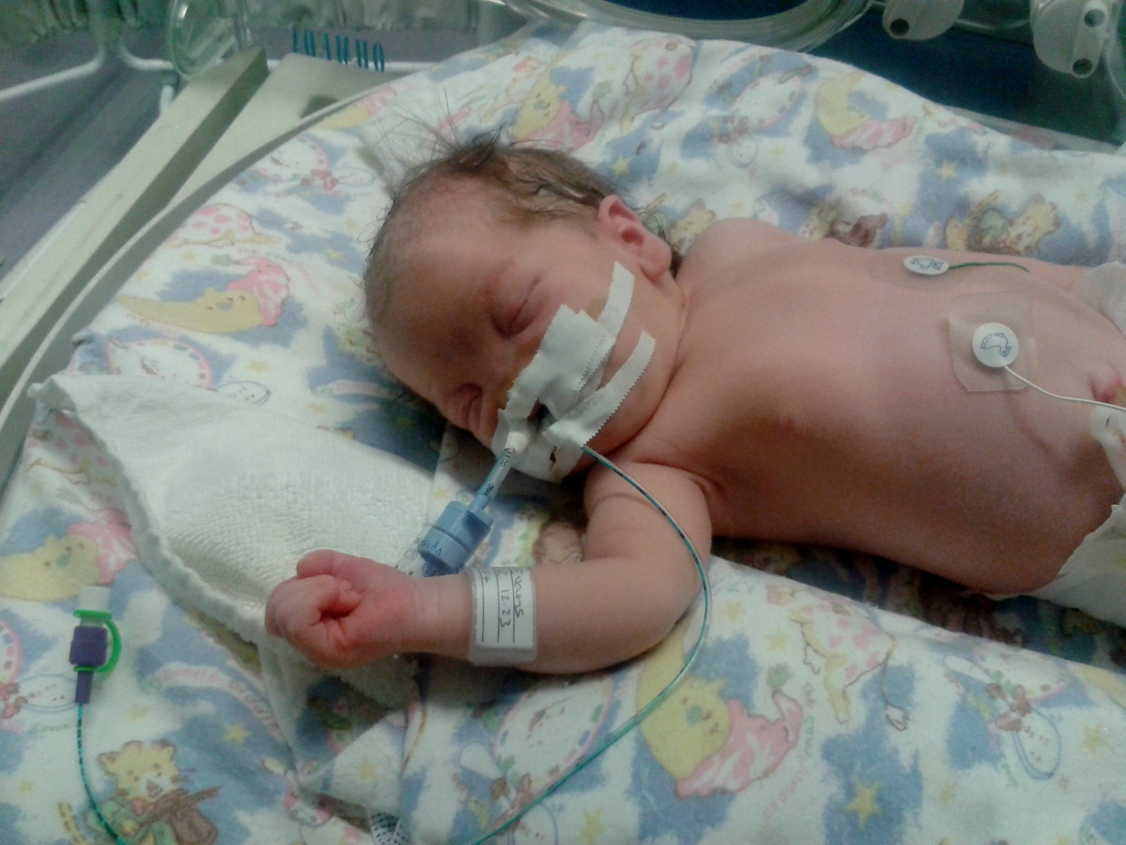

Slide 4
NICU
“Minimal Handling Recommended.”
Upsetting and Difficult.
Expected to go home.
Strict and isolating.

Slide 5
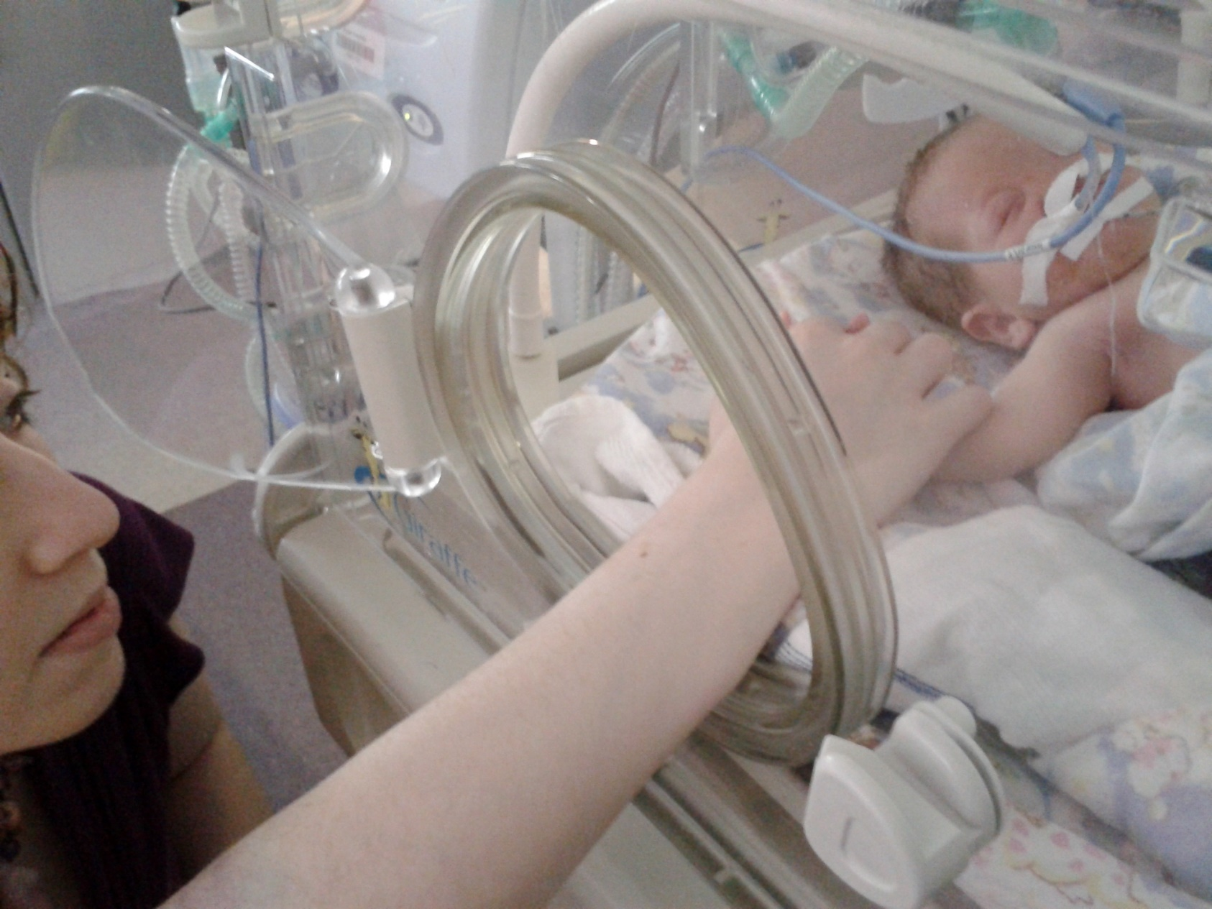

Slide 6
PICU
Total maternal access
Allowed to stay
Successful breastfeeds
Less stressful
Privacy easily accessible

Slide 7
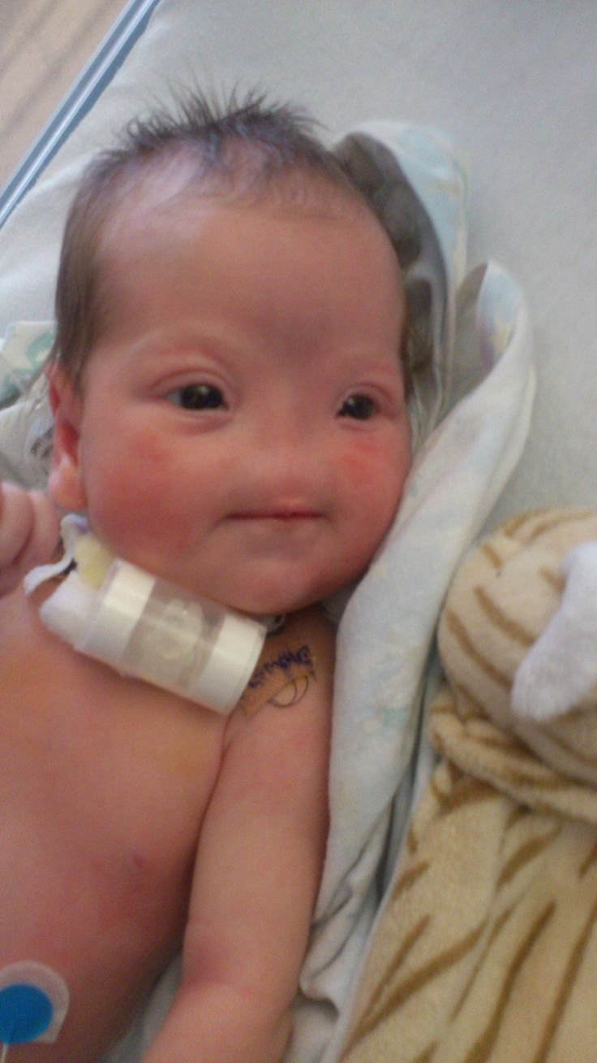
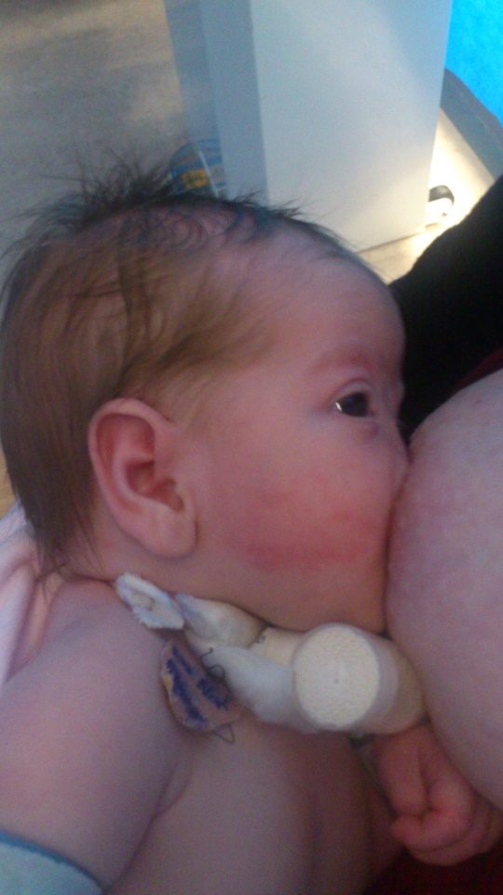
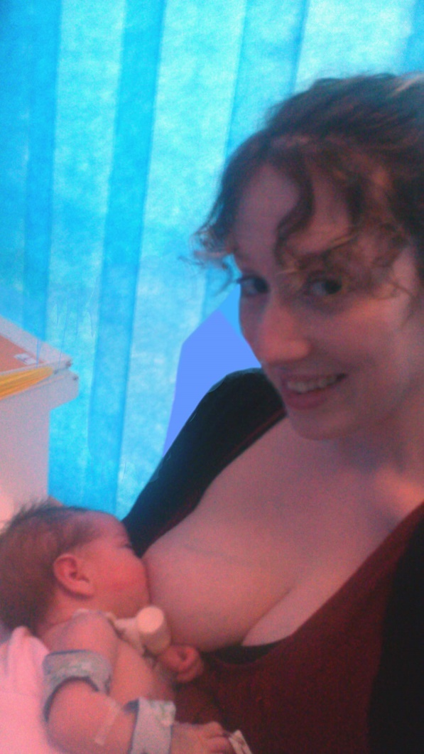
Tessa with her new trachy.
Our first breastfeed .10 days old

Slide 8
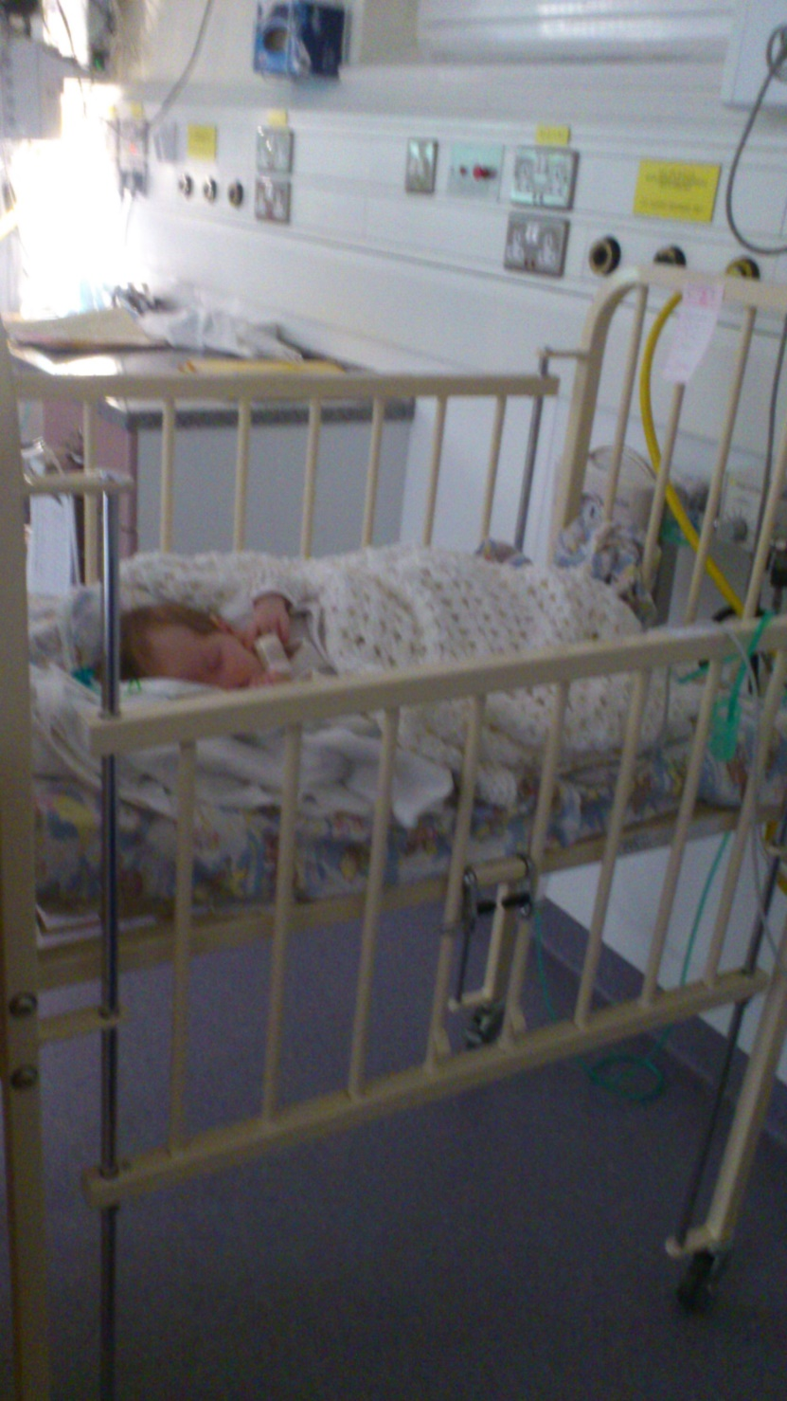
Tessa’s Cot in NICU

Slide 9
Barriers to Breastfeeding in NICU
Not allowed to try without SALT assessment.
Not allowed to remove OG tube.
Not allowed smaller, upright, more frequent tube feeds.
Not given enough time or privacy.
No kangaroo care or skin to skin encouraged.
Only hard upright chairs available.

Slide 10
Memories from NICU

Slide 11
Establishing Breastfeeding at Home
Bait and Switch
From bottle to breast.
Exaggerated Latch Technique
(The Flipple)
Motion
(bouncing/ walking/
Swaying)
Expert Support
from
La Leche
League
Belief & Perseverance

Slide 12
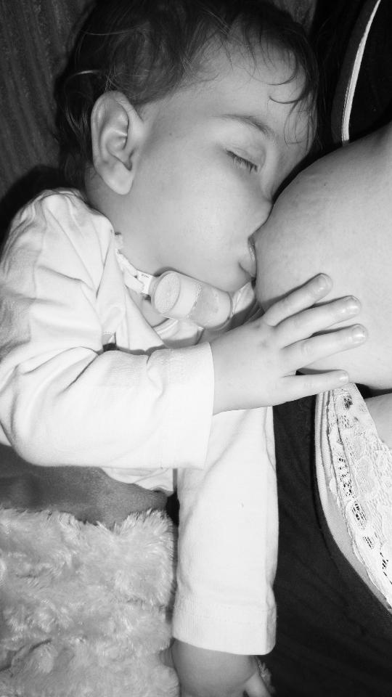
Exclusively breastfed by 8 weeks

Slide 13
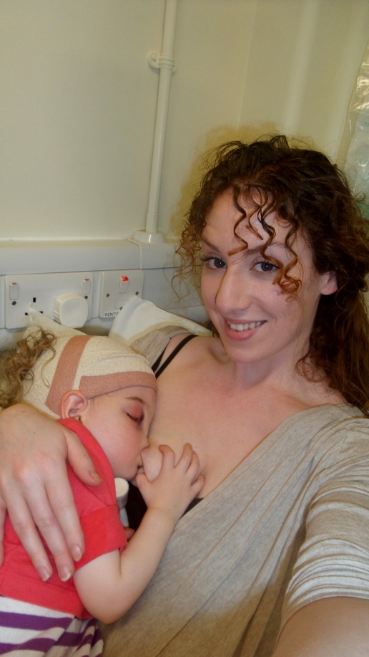
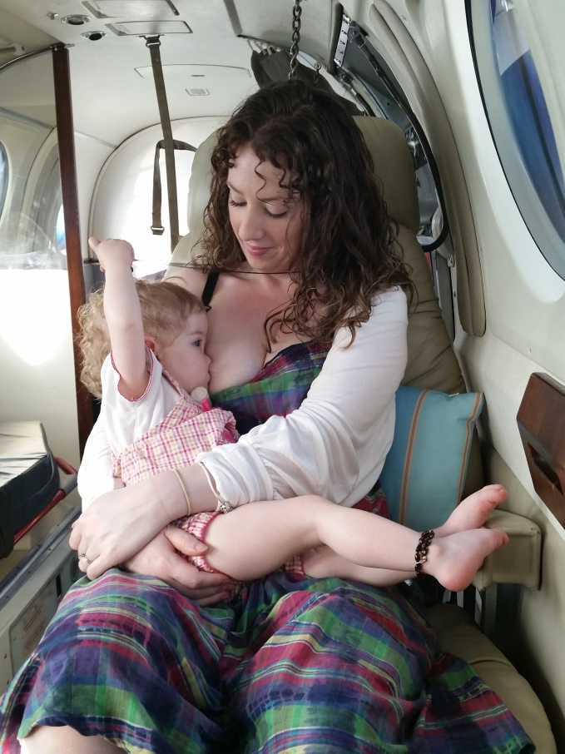
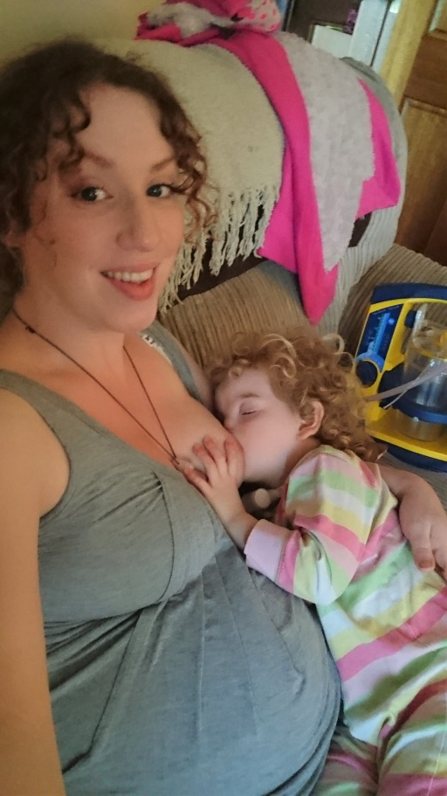
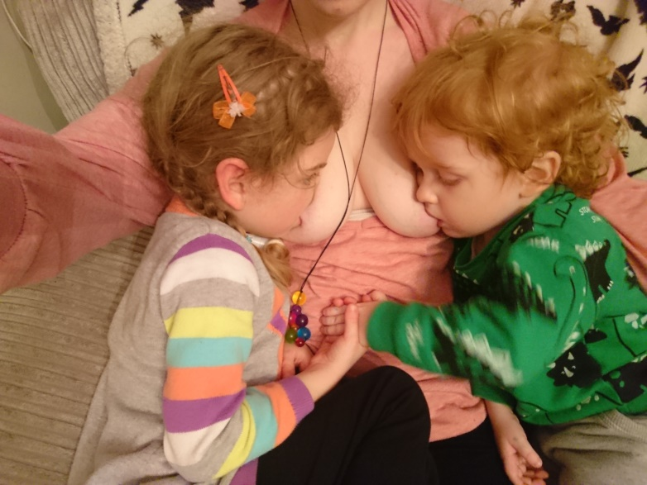
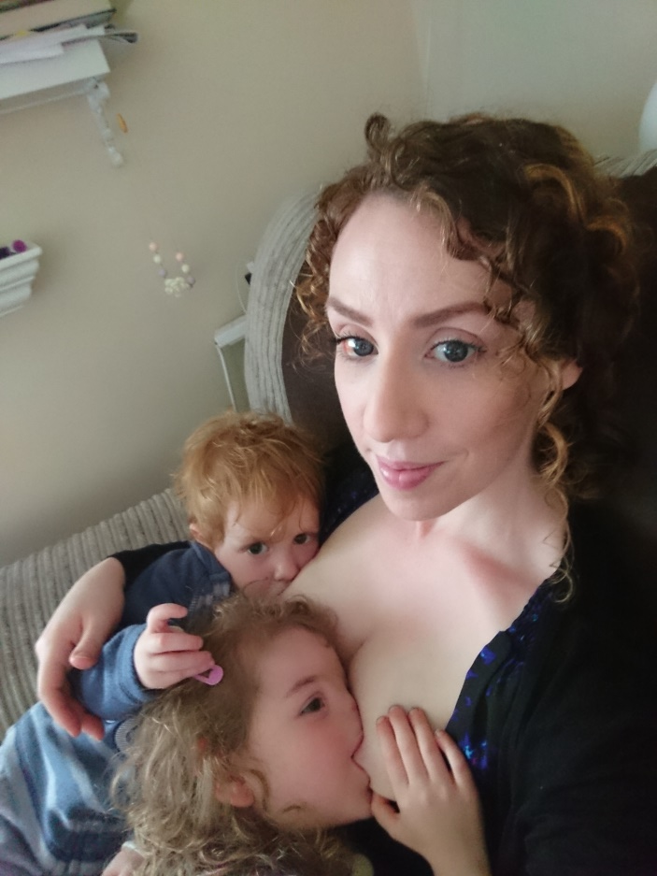
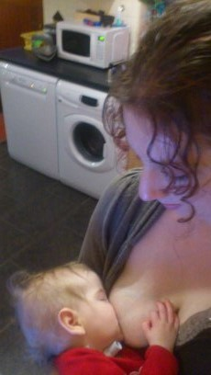
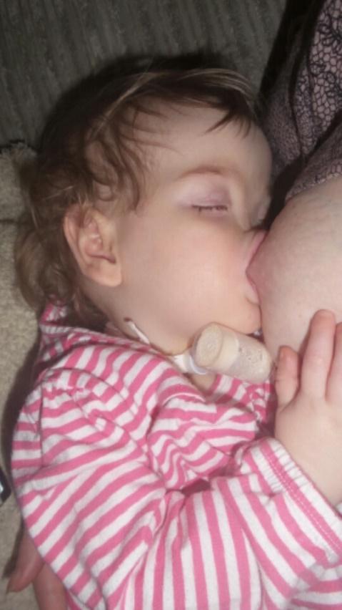
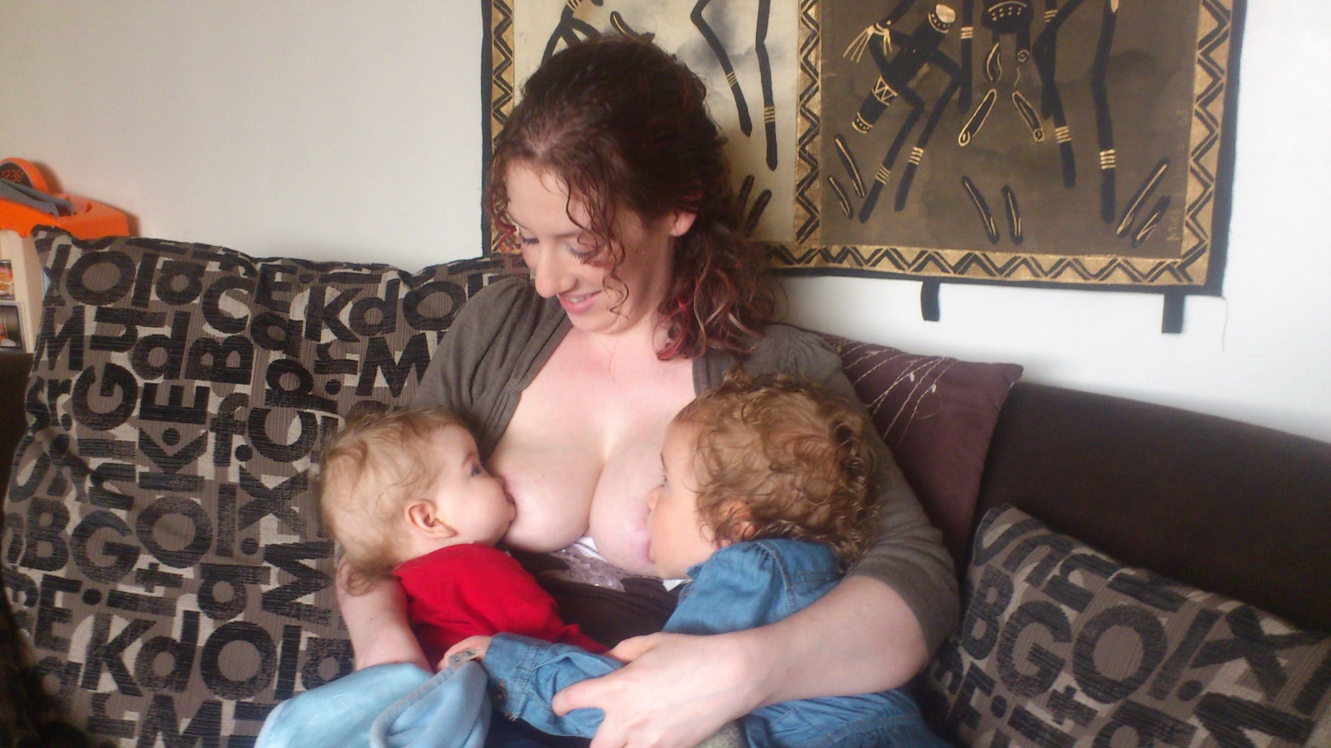
Our happy place

Slide 14
Special needs /NICU babies
Most to gain from breastfeeding support
Risk of infection
frequent medical procedures
future surgery
Heals emotional trauma of separation
Risk of illness
Eases pain
Faster physical healing
Special needs/ NICU mums higher risk for mental health issues
PTSD
Anxiety
Post natal Depression
Difficulty bonding

Slide 15
Benefits of Breastfeeding Hormones for Maternal Mental Health
Aid Sleep
Inhibit Stress hormones
Support bonding
Boost feelings of love and ability to feel loved
Promote
relaxation

Slide 16
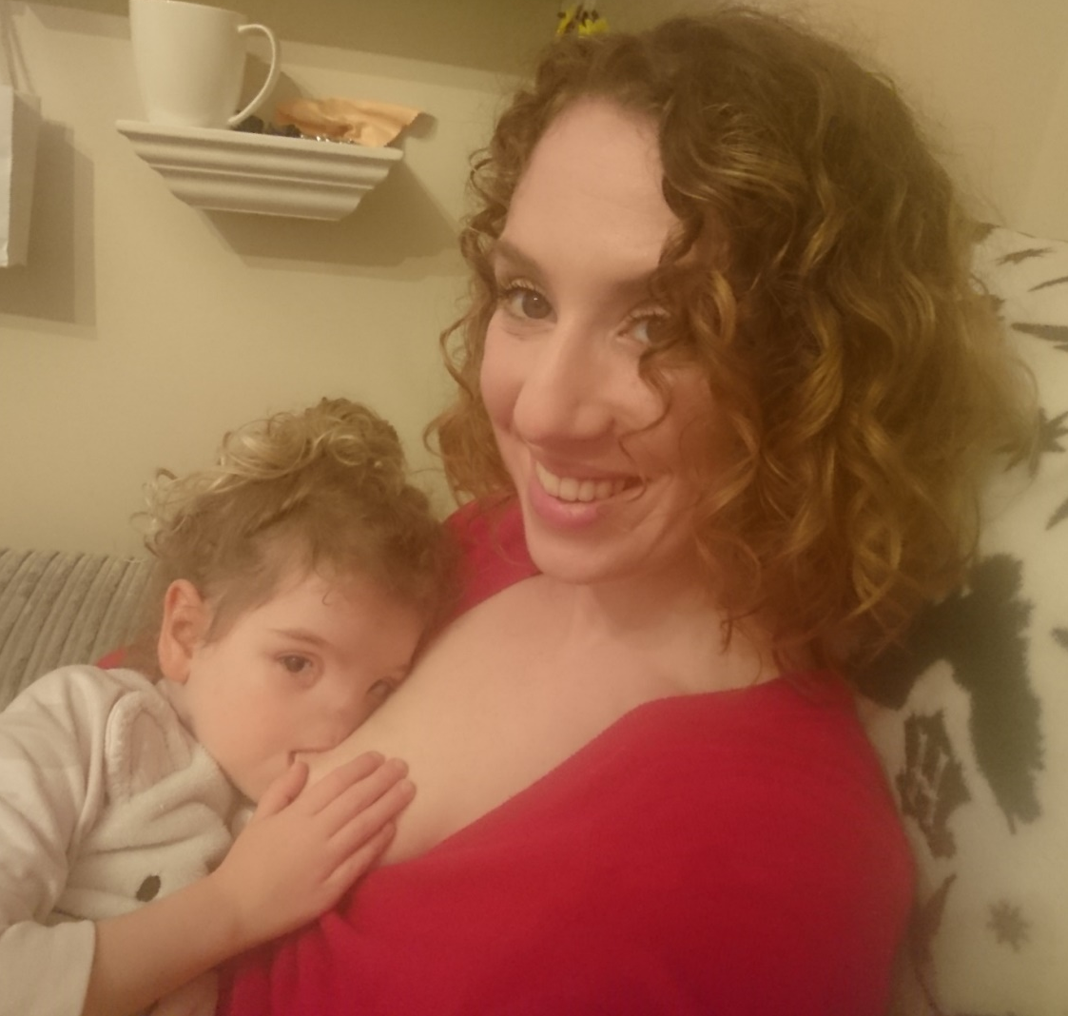
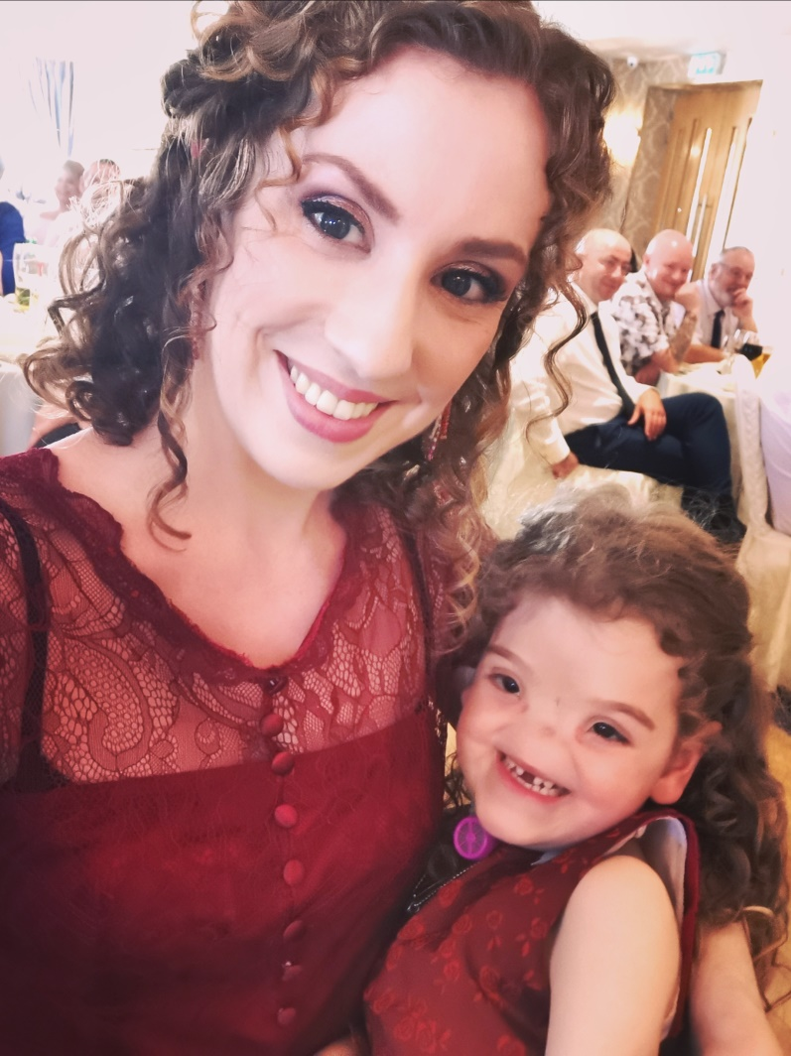
All families deserve the chance to experience the same physical, mental and emotional healing that we got from our breastfeeding journey.

