Slide 1
Synthesising the evidence to support breastfeeding practice
Prof Dame Tina Lavender

Slide 2
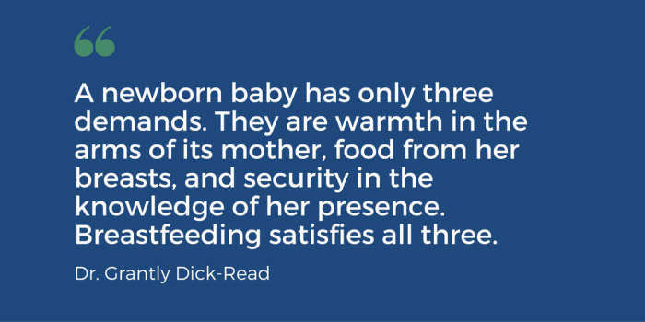
Do we need evidence?

Slide 3
Do we need evidence?
“Something so natural”
“All women can do it”
“It’s like riding a bike”

Slide 4
Like riding a bike
Think about learning to ride a bike
It’s free, good for you, pleasurable
But imagine that you hadn’t seen anybody riding a bike before…. Would this make it more difficult?
Imagine you had one friend who tried to ride one once, but she fell off a lot and told you about the awful scabs on her legs.
But you persevere and buy a bike, learn the theory and are determined to be successful
What’s missing from this scenario?
http://www.workandpump.com/bike.htm

Slide 5
Breastfeeding Rates

Slide 6
Global situation
78 million babies globally (3 in 5) are not breastfed within the first hour of life
Puts them at higher risk of death and disease and makes them less likely to continue breastfeeding.

Slide 8
Ireland
60% of babies are breastfeeding on discharge
49.5% exclusively feeding
[2016 Perinatal Statistic report]
10.5% of mothers breastfeed exclusively for more than six months
37.7% for less than six months
50.1% said they had never done it
[Rito A, et al. 2019 Obesity Facts, in Press ]

Slide 9
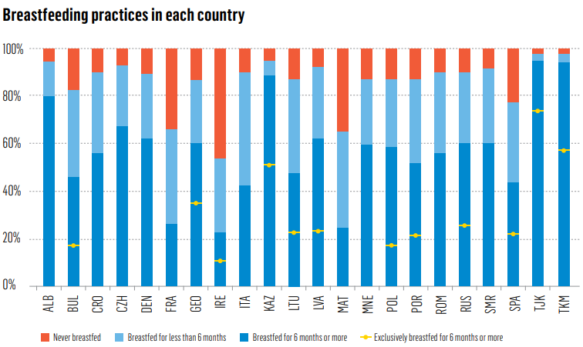
The WHO European Childhood Obesity Surveillance Initiative: COSI 2015/2017. Obesity Facts (In Press).

Slide 10
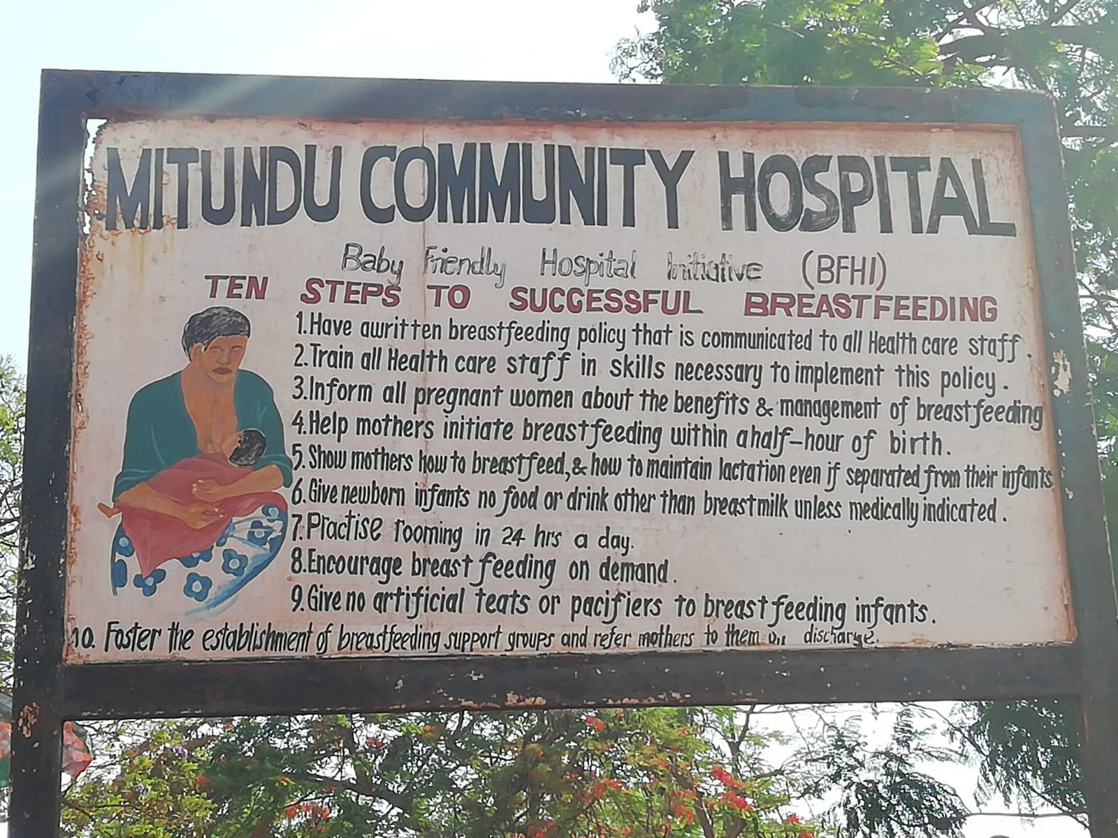
Exclusive Breastfeeding 71% in 2011 and 61% in 2016

Slide 11
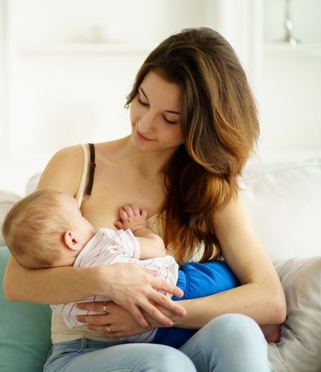
Why are rates so bad?
If everyone that wanted to breast feed succeeded then we wouldn’t need ‘scientific’ evidence….. But they don’t

Slide 12
Cochrane

Slide 13
What Evidence counts?
Systematic review
Meta-synthesis
Primary research
Implementation research
Pubmed: 54,651 studies

Slide 14
How do we apply the evidence?
BF doesn’t happen in a vacuum
Culture/Environment
Peers/family
Body image

Slide 15
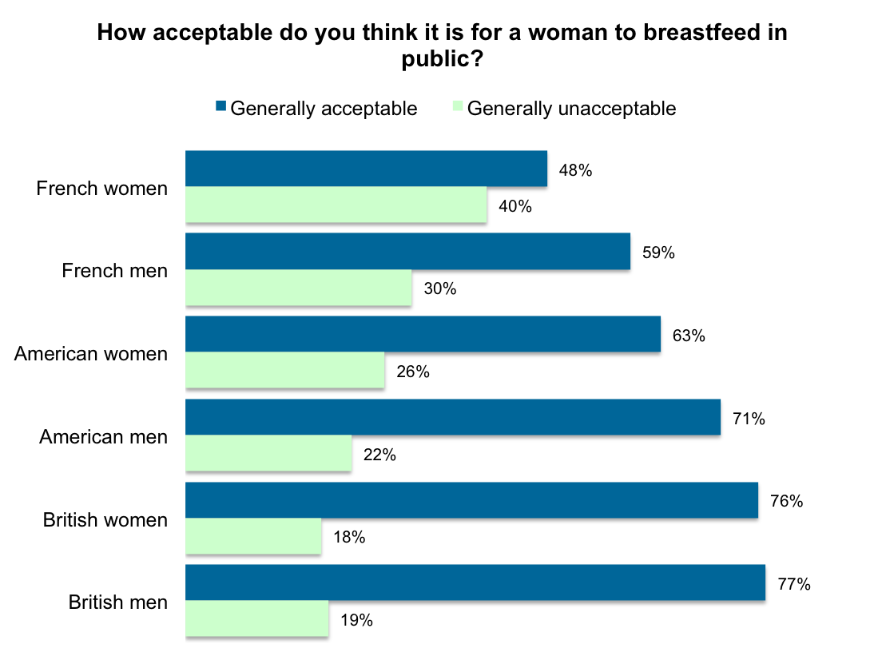
YouGov.com 2013

Slide 16
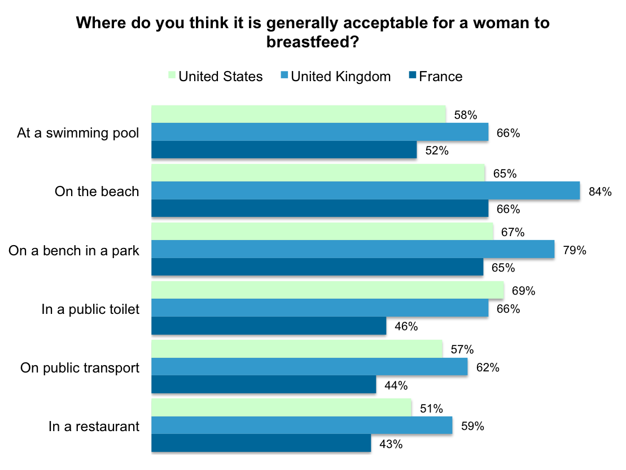

Slide 18
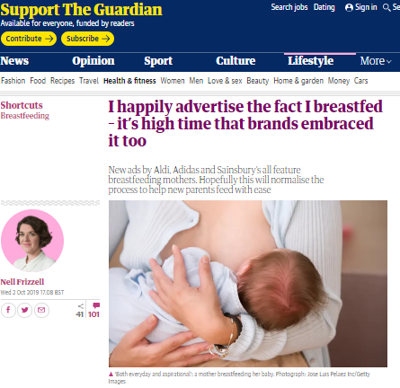

Slide 19
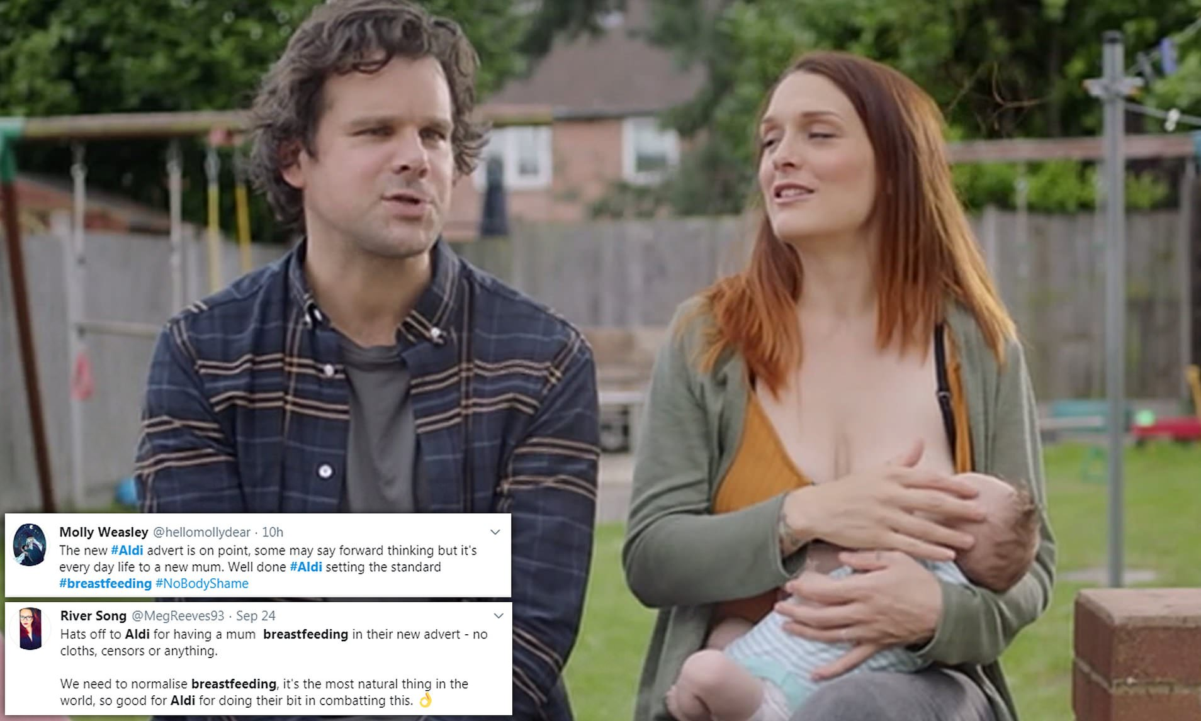
The Advert

Slide 20
Breastfeeding in women with a BMI ≥30kg/m²
Stephanie Lyons
Supervised by Dr Debbie Smith, Dr Sinead Currie, Dr Sarah Peters and Professor Dame Tina Lavender

Slide 21
Background
Women with a BMI ≥30kg/m²:
less likely to initiate BF
Turcksin et al., 2014
shorter duration of BF
Anstey et al. 2011
Observations with pregnant women with a BMI ≥30kg/m²
One group of women all B/F due to social support
Opportunity for behaviour change.
Smith et al. 2016

Slide 22
Programme of work
PPI and stakeholders
Systematic review
Meta-synthesis
Secondary analysis of data
Qualitative inquiry
Development of an intervention

Slide 23
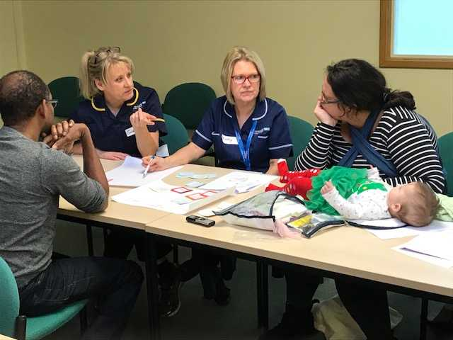
PPI and stakeholders
Aim: to explore what research is needed to help women with a BMI over 30 breastfeed
BMI closes avenues in pregnancy = medicalised so determined to take back control
Physical barrier = Clothing, breast size and complication in pregnancy
Invaluable insights to enhance research from design stage

Slide 24
Systematic Review Published Obesity Reviews (2018)
Which psychological factors are associated with breastfeeding behaviours in women with a BMI of ≥30kg/m²?
Over 7000 studies identified, 20 included
16 psychological factors
5 categories:
Intention to breastfeed
Expectations and beliefs about breastfeeding
Maternal confidence
Mental health
Breastfeeding knowledge

Slide 25
Implications
Psychological factors are associated with breastfeeding behaviours
What health professionals can do:
Encourage women to plan to breastfeed
Promote women’s ability to breastfeed
Signpost to breastfeeding support groups
Review was inconclusive for intervention development

Slide 26
Meta-Synthesis
Aim:
To combine relevant qualitative findings to understand the perceptions and experiences of women with a BMI ≥30kg/m² who breastfeed.
Included 5 studies
One theme: weight amplifies breastfeeding difficulties
Three subthemes

Slide 27
What are the perceptions and experiences of women with a BMI ≥30kg/m² who breastfeed?
Weight amplifies breastfeeding difficulties
Psychological reactions to medical intervention
Perception of body’s ability to breastfeed
Additional need for support
Notes:
** Need to change 20 to 5

Slide 28
Findings
Psychological reactions to medical intervention:
Disappointed with birth experiences
High risk label in pregnancy
Lack of privacy
Out of control
Unmotivated

Slide 29
Findings
Psychological reactions to medical intervention:
“I was just shaking all over, like complete shaking so I was like, ‘I don’t feel like I can hold him” (Eve)
“And then I got really bummed because she was only able to stay on me for a couple of minutes. The nursery came and got her because her blood sugar levels were low” (Allison)

Slide 30
Findings
Perception of body’s ability to breastfeed:
Difficulty latching and positioning
Difficulty finding clothing
Lack of belief in body’s ability to breastfeed
Planning
Belief in breast milk quality

Slide 31
Findings
Perception of body’s ability to breastfeed:
‘‘She’s probably over 300 pounds and tried to breastfeed but this poor little baby, you know, you try and nurse a little tiny baby and their nose is right next to their mouth, like truly was smothered by this woman’s breasts. And I think the effort that it would go into for her to breastfeed was just too much.’’ (MD)

Slide 32
Findings
Additional need for support:
Latching and positioning
Social support
Feeling a nuisance
Feeling uncomfortable
Misunderstanding the purpose of services

Slide 33
Findings
Additional need for support:
‘‘Larger women don’t even want to expose any part of their body, let alone their breast. You can’t be as private or discreet when you have larger breasts, larger body’’ (LC)

Slide 34
Implications
Women’s weight amplifies their breastfeeding difficulties
What health professionals can do:
Empower women to breastfeed despite medical intervention
Promote women’s ability to breastfeed and produce quality milk
Signpost to and ensure understanding of the purpose of breastfeeding support

Slide 35
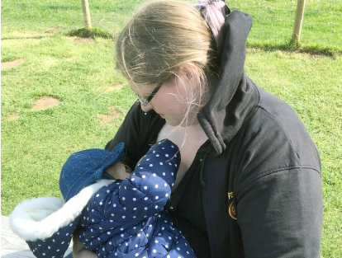
Implications
Intervention development – can we look at these psychological factors in more detail?

Slide 36
Secondary Analysis
Aims:
To identify whether psychological factors associated with breastfeeding are reported by women with a BMI ≥30kg/m² as part of their breastfeeding experience
To examine how these psychological factors influence breastfeeding behaviour

Slide 37
Secondary Analysis
Data from 18 interviews with women with a BMI ≥30kg/m² who had breastfed.
Deductive thematic analysis using framework of psychological factors identified in systematic review.
All psychological factors reported; 1048 quotes coded.

Slide 38
Secondary Analysis
Intentions to breastfeed:
All women intended to breastfeed, but different plans for duration.
Intention motivated successful initiation.
Planning short durations increased confidence in ability.
Maternal confidence:
Confidence in ability extremely important, gained by receiving support and encouragement from other breastfeeding women.
Women needed confidence to breastfeed publicly.

Slide 39
Secondary Analysis
Expectations and beliefs about breastfeeding:
Women believed in their breast milk’s nutritional adequacy and sufficiency
Others approval of breastfeeding was important
Women had positive beliefs about breastfeeding and expected breastfeeding to assist weight loss, but these beliefs needed to be realistic to avoid negative impact
Breastfeeding knowledge:
Factual knowledge promoted control and confidence in ability to breastfeed
Social knowledge increased confidence and facilitated factual knowledge sharing

Slide 40
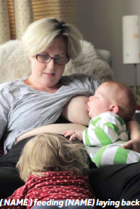
Secondary Analysis
Psychological wellbeing:
Poor body image leads to low confidence in body’s ability to breastfeed and breastfeeding publicly
Women feeling down, anxious or stressed gained factual knowledge and social support to help them continue breastfeeding

Slide 41
Interview study
What can be learnt from the experiences of women with a BMI ≥30kg/m² who have breastfed and/or are currently breastfeeding?
Participants:
BMI ≥30kg/m²
Had breastfed and/or were breastfeeding
Aged 18-45 years
Online recruitment:
Email, social media groups
Telephone interviews:
Semi-structured interview schedule
Piloted and PPI informed
Audio recorded and transcribed

Slide 42
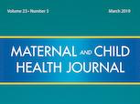
What can we learn from women with a BMI ≥30kg/m² who have breastfed and/or are currently breastfeeding?
Inductive thematic analysis
“I found it a lot harder because I had bigger breasts, and even just the fact that cos I’ve got a little bit of weight round my middle means that being able to get him like closer into me when I’m breastfeeding has been harder” (Freya)
Personal control over breastfeeding behaviour
Seeking support to overcome a medicalised experience
Seeking information to overcome social and practical barriers
Notes:
** N = 18, needs to be changed
Participants (n=18):
BMI ≥30kg/m² / Breastfed / 18+ years old.
Online recruitment
Telephone interviews (mean = 42 mins / SD = ??):
Semi-structured interview schedule
Piloted and PPI informed
Inductive thematic analysis
Two themes.

Slide 43
What can we learn from women with a BMI ≥30kg/m² who have successfully breastfed and/or are currently breastfeeding?
“All the literature and everything was all geared up for like six months isn’t it […] and then you’ve kind of done you’re bit, past six months you’re kind of getting the ‘how long are you gonna be feeding him for?’, after a year they’ve just realised you’re slightly weird” (Bethany)
Realistic expectations of the breastfeeding journey
Being informed about weight, nutrition and breastfeeding
Normalising maintenance beyond six months
Notes:
Participants (n=18):
BMI ≥30kg/m² / Breastfed / 18+ years old.
Online recruitment
Telephone interviews (mean = 42 mins / SD = ??):
Semi-structured interview schedule
Piloted and PPI informed
Inductive thematic analysis
Two themes.

Slide 44
Implications
It is important we encourage women with a BMI ≥30kg/m² to breastfeed
These studies explain why these women are breastfeeding less, and what we can do to help
Psychological factors influence breastfeeding behaviours

Slide 45
What Health Professionals can do
Encourage women during pregnancy to plan to breastfeed for initially short durations, but to review and extend in line with the WHO recommendations
Promote benefits of breastfeeding only when accompanied by realistic information about breastfeeding experiences
Inform and support women to lose weight safely whilst breastfeeding
Discuss the benefits of attending breastfeeding support groups
Help women regain control over their decisions

Slide 46
Implications
Need for evidence-based intervention:
¾ previous interventions trialled are unsuccessful
Methodologically limited
Not theoretically informed
No psychological interventions

Slide 47
Intervention
Built on :
Women feeling in control of their breastfeeding behaviours, particularly when ‘high risk’
Increasing realistic expectations
Aligning health professional training with women’s needs
Raising awareness of importance of confidence/body image
Designing an intervention to support intention and maintenance

Slide 48
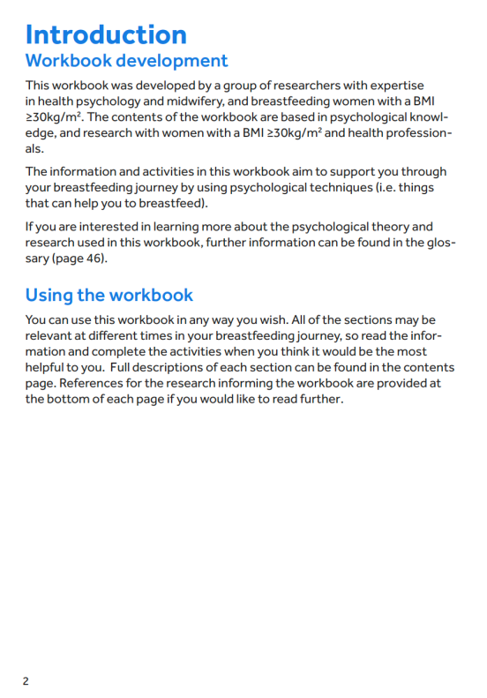
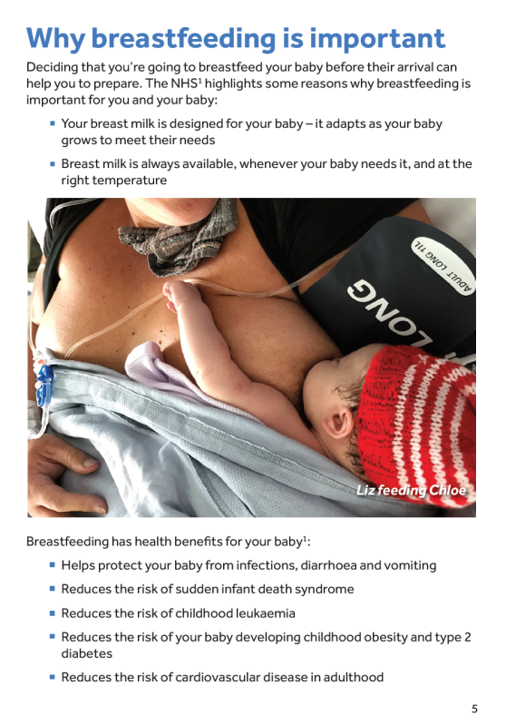
Intervention to support breastfeeding in women with a BMI ≥30kg/m²

Slide 49
Theory
The workbook were based upon the Integrated Change Model.
This model states that the primary determinant of a person’s behaviour is their intention to perform the behaviour, but that this can be influenced by ability factors and barriers that get in the way of a person performing a behaviour.
For someone who intends to perform a behaviour, if their ability factors are high, and the barriers are low, they are more likely to perform the behaviour.

Slide 51
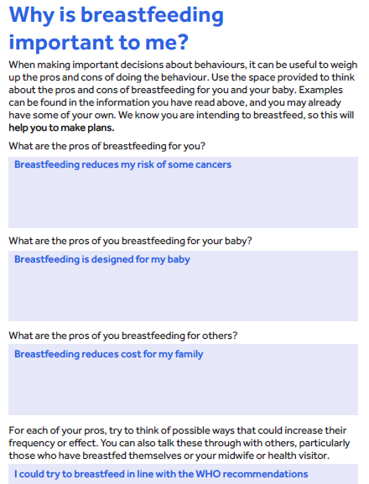

Slide 52
Do we need evidence?
Yes and No
No, we do not need to prove that breastfeeding is better
Yes, we do need to find the best ways to support women to achieve their individual breastfeeding goals
Properly informed
Rigorously designed

