Slide 1
BFNI Support Update
Carol Smyth presenting pp BFNI Admin Team

Slide 2
What I want to cover
Reminder of who we are & what we do
What women are saying
Implications for research & practice

Slide 3
BFNI Overview
Facebook Group
Closed Group >10000 members
Providing evidence based information & support
Peer support
Moderated entry & Moderated comments
Facebook Page - Breastfeeding Education

Slide 4
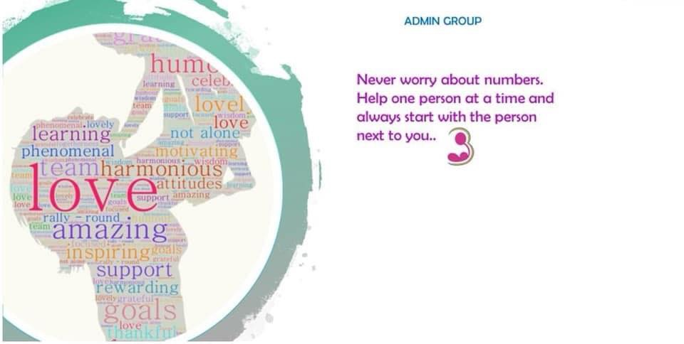
BFNI Admin
BFNI is not a free for all support group.
Very dedicated admin team
13 members
1 GP
1 IBCLC, 3 LLL Leaders, 2 in LLL leadership training
1 trained with NCT BFC, 4 active peer supporters
2 working/training in psychological therapies & therapeutic counselling
1 Women’s Aid Support Worker
Over 60 yrs breastfeeding experience

Slide 5
A day in BFNI
00:19 - How to wean toddler
06:32 - Biting during feeding
07:06 - Irrelevant post
07:22 - Proud of feeding
09:30 - Proud of bf while baby is sick
10:28 - Photo of prof photo celebrating bf
10:41 - Comedy meme
10:42 - How do I wean to formula
12:38 - Advert for bf clothes
13:16 - Gutted that baby isn’t gaining
13:21 - Biting during feeding
14:01 - Feeding in public
14:40 - Question about feelings of fullness
15:10 - Feeling nauseous
16:13 - Admin shared a post on twiddling 16:34 - Proud of exclusive feeding
18:40 - Bf Group meeting Time
19:46 - BF Group meeting Time
20:11 - Admin share from BfN
21:14 - How to night wean
21:37 - Returning to work
23:03 - Breasts leaking after weaning 23:35 - Proud of feeding

Slide 6
Post Snapshot
Plea for help 42%
Information Post 17%
Celebration 25%
Self empowerment is key
“Maternal breastfeeding self-efficacy is a significant predictor of breastfeeding duration and level. “ Blyth et al 2008

Slide 7
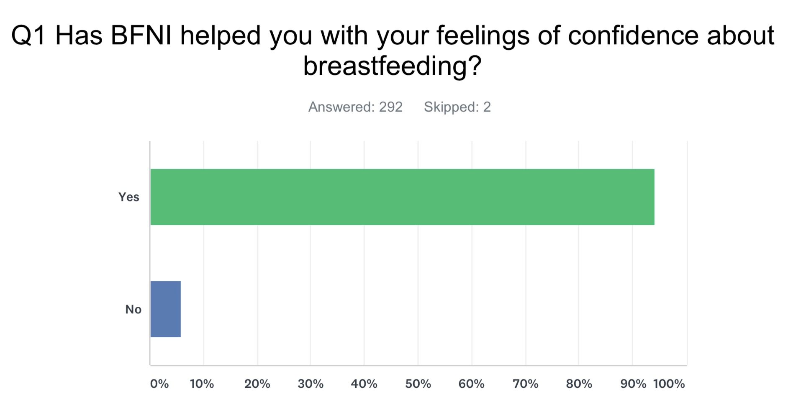
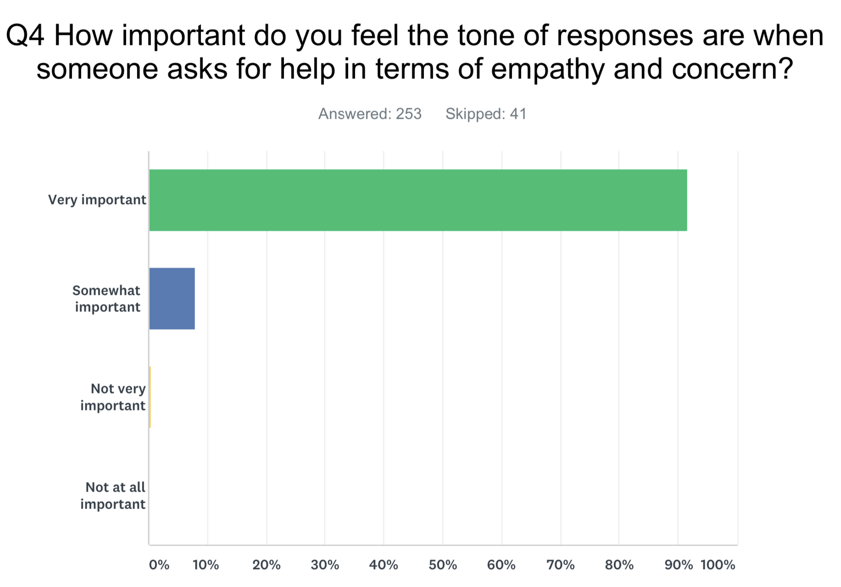
BFNI Support Survey

Slide 8
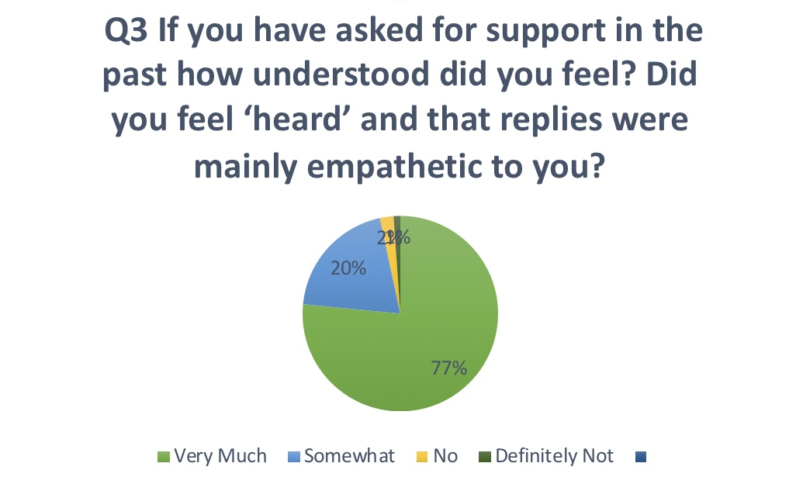
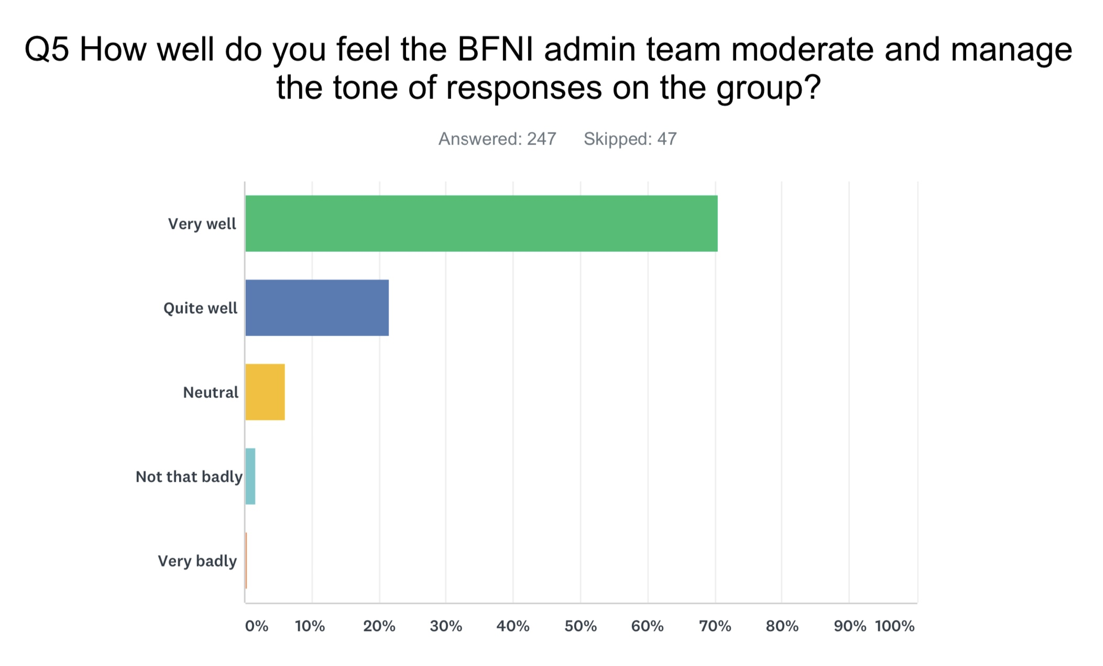
BFNI Support Survey

Slide 9
What women say...
“advised..it’ll make no difference now”
“told me ‘they look fine’ [nipples]..”
“was completely fobbed off”
“Feeling so heartbroken today”
“I’m in agony”
“I’m at my wit’s end and it’s making me utterly miserable”

Slide 10
What women say...
“I’m really confused”
“I was near by myself. Spent the rest of the afternoon/evening very emotional and on edge”
“Disappointed with my experience”
“Feeling amazing today...I am glad I didn’t give up on breastfeeding”
“She said... ‘I am feeding him too much...I’m giving him wind”
“She was insensitive / unsupportive”
“His response was you need to knock that on the head...He hadn’t actually asked me if the night feeds bothered me or how I was coping”
“Constant battle with midwives and doctors”

Slide 11
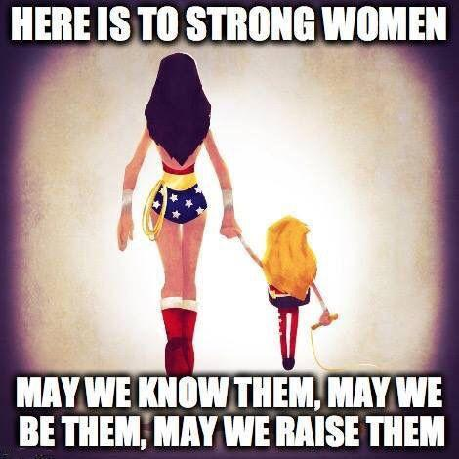
Implications for Research
Previous Spotlight Events
Women want to feel heard
Behaviour Change needs Skills & Value
“Maternal breastfeeding self-efficacy is a significant predictor of breastfeeding duration and level. Integrating self-efficacy enhancing strategies may improve the quality of care that health care professionals deliver and may increase a new mother’s confidence in her ability to breastfeed, and to persevere if she does encounter difficulties”
Blyth et al 2008

