Slide 2
Professor Marlene Sinclair

Slide 3
“The main objective of the DMRS is to provide quality support and guidance to doctoral and post doctoral midwife and childbirth (or related) researchers regionally, nationally and internationally.”

Slide 4
Connect with the
https://www.facebook.com/groups/475782952477092/
@OfficialDMRS
Doctoral Midwifery Research Society

Slide 5
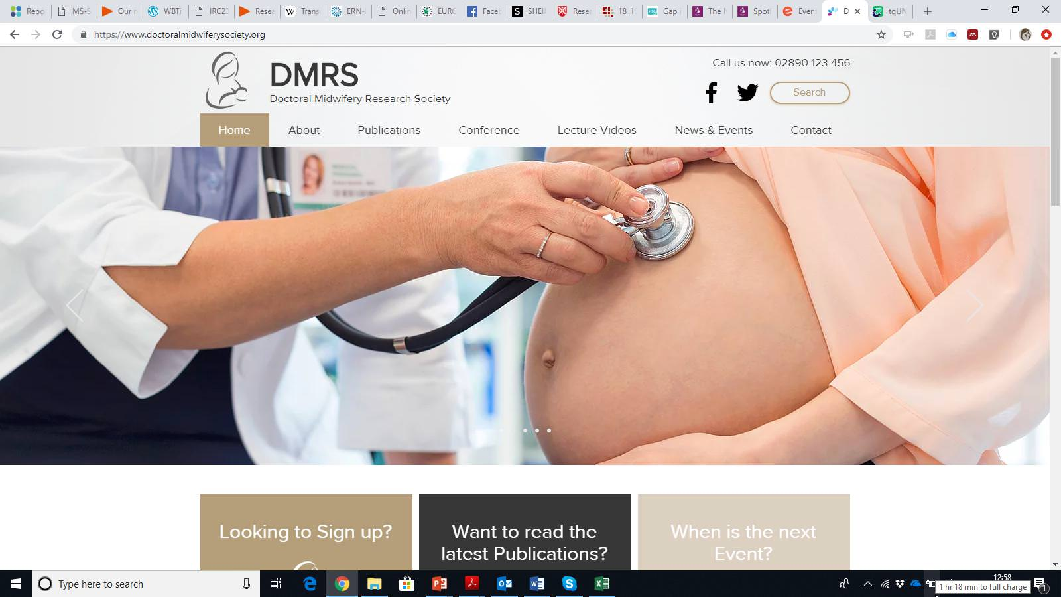

Slide 6
Breastfeeding Issues for parents with children with Down Syndrome, Spina Bifida, Cleft Lip/Palate and Heart Disease: Preliminary findings from the ConnectEpeople project
Professor Marlene Sinclair - Ulster University
Dr Julie McCullough – Ulster University Professor Anna Latos-Bielenska - Poznań University, Poland Dr David Elliott – Redburn Solutions, Northern Ireland

Slide 7
Demographic characteristics of the survey respondents
Characteristic |  | Number of Respondents
Mother |  | 75
Father |  | 5
Age | 38.3 (+/- 6.77) years | 80 respondents (range 24-58)
Relationship status | Partner | 74
 | No partner | 6
Able to speak English | Yes | 79
 | No | 1
Educational attainment | Secondary Education | 4
 | Diploma | 14
 | Undergraduate | 29
 | Post-graduate | 33
Condition of child | Down Syndrome | 28
 | Spina Bifida | 28
 | Cleft | 16
 | Heart Disease | 8

Slide 9
How did you feed you child when they were a baby?

Slide 10
How many weeks did your baby have breast milk?
On average babies received breast milk for 35 weeks.
Some women reported that they fed their baby for 4 years

Slide 11
Did you experience any difficulties feeding your baby (n=80)

Slide 12
What areas did you have difficulties with?

Slide 13
Why did you stop breastfeeding your baby?

Slide 14
I had to go back to work.
I was expressing but dietitian felt he needed higher calorie feeds for all bottles
He was almost 4!
He needed high energy milk
Because I had problems with lactation due to constant atress and problems with pumping my milk during our attendance at hospitals.

Slide 15
Child was losing weight..need high calorie prescription milk
I had no milk propably because of the stress , baby was in the hospital for 5 days when he was 6 months old
Both, the baby and me where exhausted frame trying
I had to stop because I did not have the energy to proceed when she was that ill.
I thought It was the right time - one year and one month of brest feeding.

Slide 16
Did you receive any additional help feeding your baby?
39% said No
61% said Yes
The most helpful advice came form midwives
The least helpful advice cane from hospital doctors

Slide 17
Are there any sources of information or advice that you feel would have helped you to feed your baby?

Slide 18
Talking to another successful breastfeeding mother
Other parents who were in similar situations to link with to discuss and reassure you
Talking to other parents with similar problems
Asking what I wanted before the baby was born. Wasn’t discussed. Baby was taken immediately to a different hospital.
video clips of other mums feeding their baby and information at the antenatal class

Slide 19
An open mind about formula feeding
More information about common issues during breastfeeding and how to overcome them or who to go to to get help for them
Video tutorials
A mum who had a baby with the same condition as mine
Expert in BF baby with heart problem

Slide 20
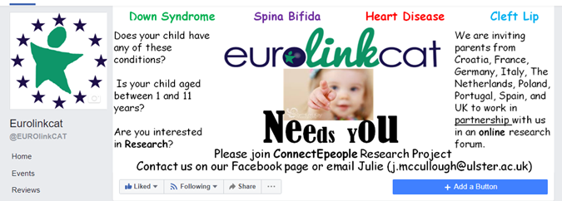
Find out more about ConnectEpeople

Slide 21
Thank you

