Slide 2
'Breastfeeding help and support’ is what women want from their postnatal care!
Dr Maria Healy
Lecturer in Midwifery (Education)
9th November 2018

Slide 3
Aims of presentation
To provide an overview & context to postnatal care in Republic of Ireland (ROI)
Discuss the evidence
To outline the research process and analysis undertaken
To present findings from doctorial research, completed in 2012

Slide 4
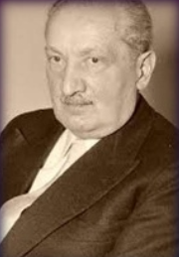
Purpose & Method of research
Aim of doctoral research - To describe and analyse Irish women’s aspirations for, and experiences of, postnatal care
To re-think and illuminate new possibilities for postnatal care Supervisor Prof. Soo Downe
Findings presented - relate to women’s aspirations for, & experiences of, postnatal care in relation to breastfeeding
Hermeneutic interpretive phenomenology, based on Heideggerian philosophy

Slide 5
Great demand for postnatal care
Birth rate in
2017 – 62,053
No national community midwifery – Only pockets of PNC!
Discharged home 24hrs – 48hrs
PHNs care for all members of the community
PHNs don’t provide weekend service
From 2007 PHNs don’t need to be RM
The context of postnatal care in Ireland

Slide 6
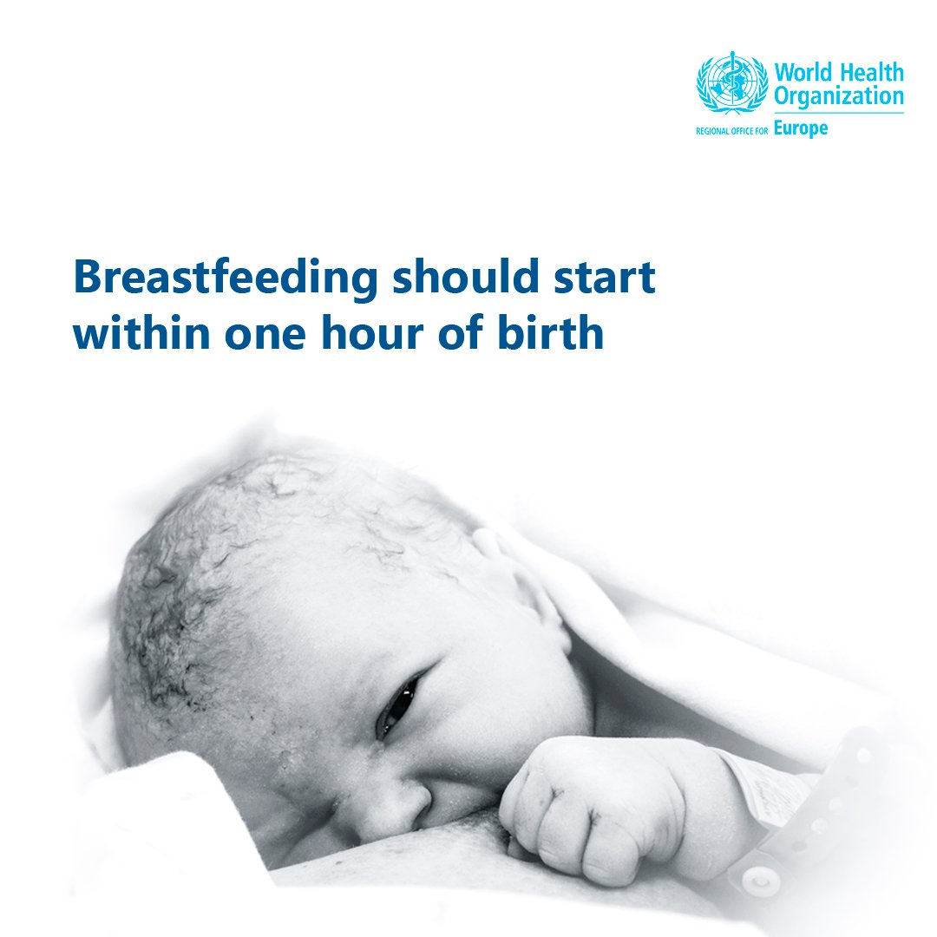
Mounting evidence that women continue to be dissatisfied with their postnatal care
Extremely vulnerable time
Maternal morbidity
Maternal mortality
‘Good mother’
Care Quality Commission, 2018 [41% of 16,525 didn’t get help within res time]; Hildingsson & Sandin-Bojo, 2011, Bhavnani & Newburn, 2010, McKellar et al. 2009, Foster et al. 2008, Rudman & Waldenstrom 2007, Hildingsson, 2007, Brown et al. 2005, Ockleford et al. 2004, DOH 2004, Singh & Newburn 2000, Mc Court et al. 1998, Audit Commission, 1997

Slide 7
Research process, recruitment & data collection
Participants recruited antenatally from an urban maternity hospital in Ireland
The women were Irish and attended either obstetric-led private, semi-private, public or midwife-led clinics
19/25 Irish women took part in a series of follow-up interviews, one before birth and two afterwards
Data Collection
Phase 1 involved six group interviews with a primigravid and multigravid group
Data Collection
Phase 2 involved 30 individual interviews with 5 primigravid and 5 multigravid women
Transcriptionist transcribed each audio taped interview & personally validated
Undertook a detailed
meta-synthesis of postnatal care

Slide 8
Analysis
MAXqda2 – narratives & field notes
Hermeneutic analysis – Interpretive process as described by Crist & Tanner (2003)
Demonstrated a rigorous approach (Plager 1994)
Audit trail

Slide 9
Findings:
What women want from their postnatal care ... Aspirations
Presencing
‘Someone who had a presence, someone who would actively listen to their concerns, no matter how trivial’.
Breastfeeding help & support…
Dispirited perception of postnatal care

Slide 10
Breastfeeding help & support - Aspirations
Women wanted to do the best they could for their baby:
Sarah explains:
‘I really, really want to have help initiating breast feeding as soon as possible after birth…, I think it’s because my mum breast fed both of us and from a really early age she just kind of said to me ‘why would people not when you know it’s all there, why would you pay somebody else to make inferior milk’.
So I just have a very fixed view on that, that’s the only thing! I’m not anxious about it, that’s far too extreme, but I am anxious that nothing gets in the way that can prevent that from happening because I know it can be hard!’

Slide 11
Breastfeeding help & support - Aspirations
Catherine reflects on her experience of inadequate breastfeeding support
‘The short fall to my care the last time, was support with breast feeding, you almost had to beg for lactation support …and by the time I did have a lady come down to me she was rushed, she was late, a lovely person as an individual but at that stage, eh the breast feeding wasn’t working out and I almost had a negative bias of it, subsequently by the time I left the hospital I didn’t breastfeed and I’m nervous about going into it this time around’
My husband doesn’t want me to try it at all, because he thinks that it was too traumatising the last time! I’m nervous that I won’t get the time from the staff to help me through it’.

Slide 12
Breastfeeding help & support – Experience
‘I felt that the midwives were too busy, they’d come over when you needed help or if you rang the bell, and they’d help, but they’d be gone…, if the baby is doing something strange you might need them to wait until they do it rather than you describing it, you know, to be able to see what the problem is’ (Therese).
Yeah the breastfeeding technical advice I got from everybody was quite helpful but each person had a slight different slant on it and that was a problem! ... it was the inconsistency of the support’ (Eileen).

Slide 13
Breastfeeding help & support - Experience
Too many visitors!
‘I was struggling anyway to breastfeed and everything makes you sensitive, you know so you’re not even, you’re not used to having your, your boob hang out and the fact that there’s strange men in the ward or strangers to you, you know you pull your curtain but you’re still very aware you know.
I would have preferred help & support to have less volume of visitors…At one stage the baby beside me had seven people in around her cube, that’s not helpful!’ (Fiona)

Slide 14
Kate highlights the impact of good breastfeeding help & support
‘I'll tell you one thing that’s really good, the lactation consultants at the hospital. I rang and spoke to them a couple of times, just advice over the phone, I found them very helpful ….
I was having problems breastfeeding and I was very sore and it turned out, I had nipple thrush... the lactation consultant, she was incredibly well informed about that particular thing and sort of diagnosed me over the phone and told me exactly what to do, go to your doctor, get this prescribed and make sure she prescribes it for this long’

Slide 15
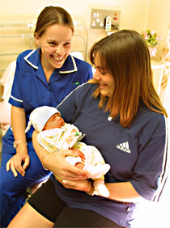
Breastfeeding help & support
Supportive behaviours from health professionals build the confidence of new mothers enabling them to breastfeed successfully, whereas inadequate support leads to early cessation of breastfeeding (Sheehan et al., 2009)
With the birth of a baby there is ‘The Birth of a Mother’ who needs to feel she is being cared for, so in turn she can care for her baby (Healy, 2012)

Slide 16
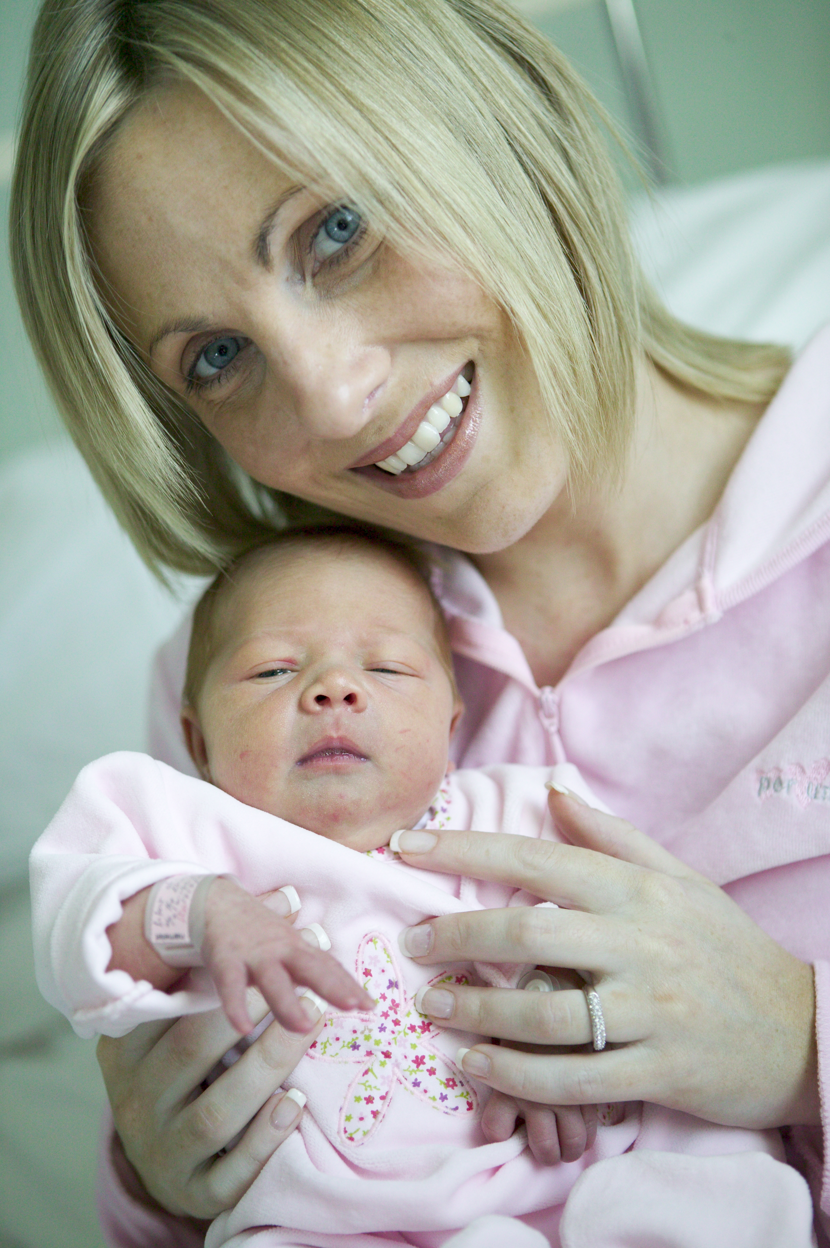
Recommendations
Midwives and other health care providers need to focus on providing authentic postnatal care which is based on the individual needs of women
Behavioural and communication skills are fundamental part of midwifery, and on-going updates should be mandatory
An effective national community midwifery service is a priority in Ireland to promote maternal and infant postnatal health and wellbeing
WHO 7/11/18 ‘#Breastfeeding gives babies the best start to life. ‘Let’s support breastfeeding mums everywhere!’

Slide 17
Thank You!
Maria.healy@qub.ac.uk

