Slide 1
Breastfeeding Research: A Funder’s Perspective Ulster University, 8 November 2019
Dr Nicola Armstrong
Programme Manager
HSC R&D Division, PHA

Slide 2
Outline
Strategic Context
Research Context
The general media
UK Research and Innovation (UKRI) news/blogs/database
Closing Thoughts

Slide 3
Breastfeeding Strategy NI
The purpose of the Strategy is to improve the health and well-being of mothers and babies in NI through breastfeeding
It sets out the strategic direction to protect, promote, support and normalise breastfeeding in NI

Slide 4
BSISG
Chair:
Brendan Bonner, Assistant Director,
Health Improvement, PHA
PHA
Tinylife
HSCTs
Early Years
La Leche League
Education
DoH
Sure Start
TAMBA

Slide 5
BSISG
Workstrand | Chair
1. Legislation & Workplace | Bryan Dooley
2. HSC & Community Support | Siobhan Slavin
3. Neonatal | Janet Calvert & Heather Reid
4. Professional training & Development | Shirley Stronge
5. Public Information | Stephen Wilson & Viola Johnston
6. Monitoring and indicators | Julie Neill
7. Research | Nicola Armstrong

Slide 6
Research Workstrand
Action 1
Review research evidence & information on effective practice in relation to breastfeeding, on an on-going basis and advise BSISG accordingly
Action 2
Influence new and ongoing breastfeeding research to build an understanding of what works in increasing breastfeeding rates in NI. In particular work with the NIPHRN, PhD programme, DMRS.
Action 3
Support breastfeeding research partnerships and explore opportunities for involvement in studies relating to breastfeeding from outside NI (page 35 of the review).

Slide 7
The General Media
3 key articles on breastfeeding research
Surveillance study
Laboratory study
Randomised controlled trial

Slide 8
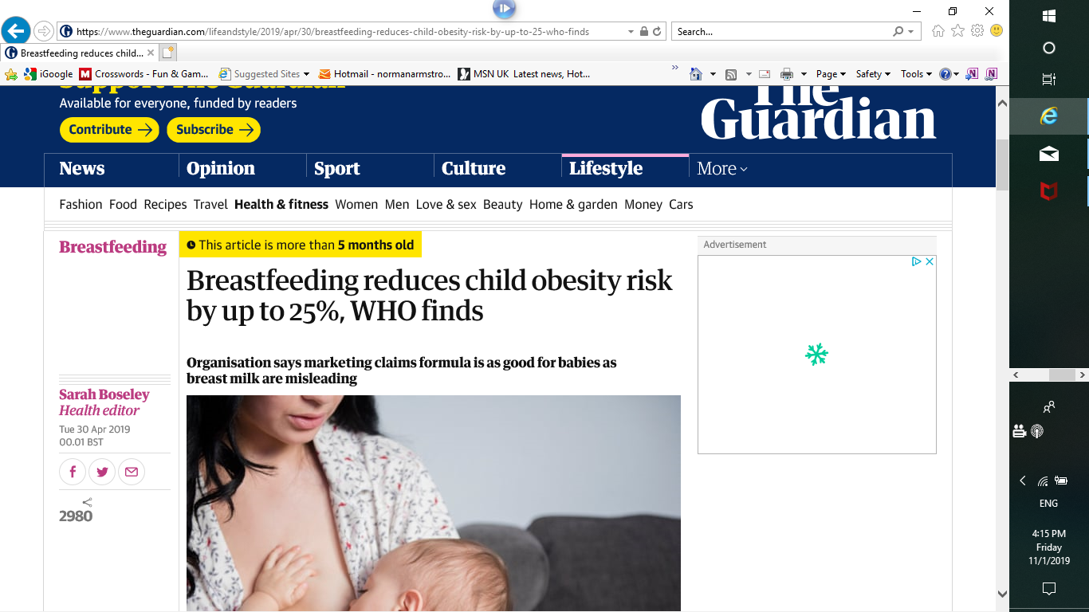
The Guardian 30 April 2019

Slide 9
Research Summary
The data came from nearly 30,000 children monitored as part of the WHO Childhood Obesity Surveillance initiative (COSI). Launched in 2007, COSI receives data from about 40 countries on children aged six to nine (not the UK)
Children who were never breastfed were 22% more likely to be obese
Those who had been breastfed for less than six months were 12% more likely to be obese than children who were breastfed for six months
Protection for children who were exclusively breastfed for six months was even higher at 25%
Kate Brintworth, head of maternity transformation at the Royal College of Midwives, said the study reinforced the need to put more resources into supporting women to breastfeed.

Slide 10
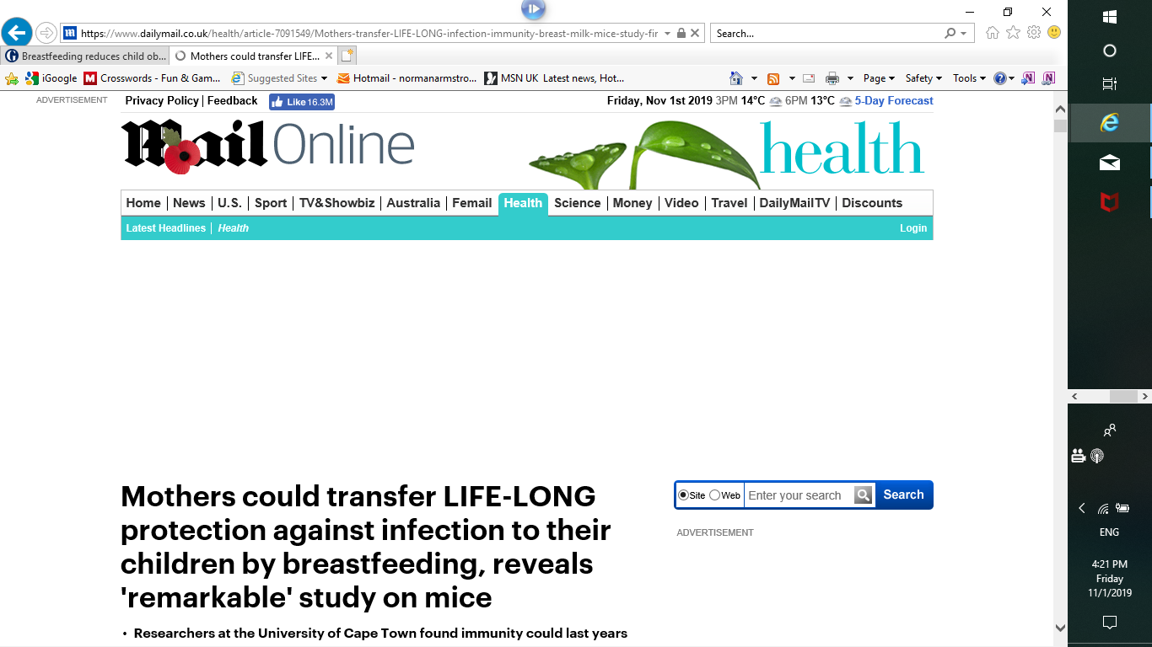
Daily Mail 30 May 2019

Slide 11
Research Summary
The research found that infant mice breastfed by a mother who had a worm infection before becoming pregnant acquired life-long protection against this infection.
This effect was passed onto the infants by cells in the mother’s milk and not proteins such as antibodies.
The work shows that exposure to an infection before pregnancy can lead to a mother transferring long term immune benefits to her offspring.
This could lead to the design of new vaccines that will be able to be given to a mother to transfer long-term immunity to her children.

Slide 12
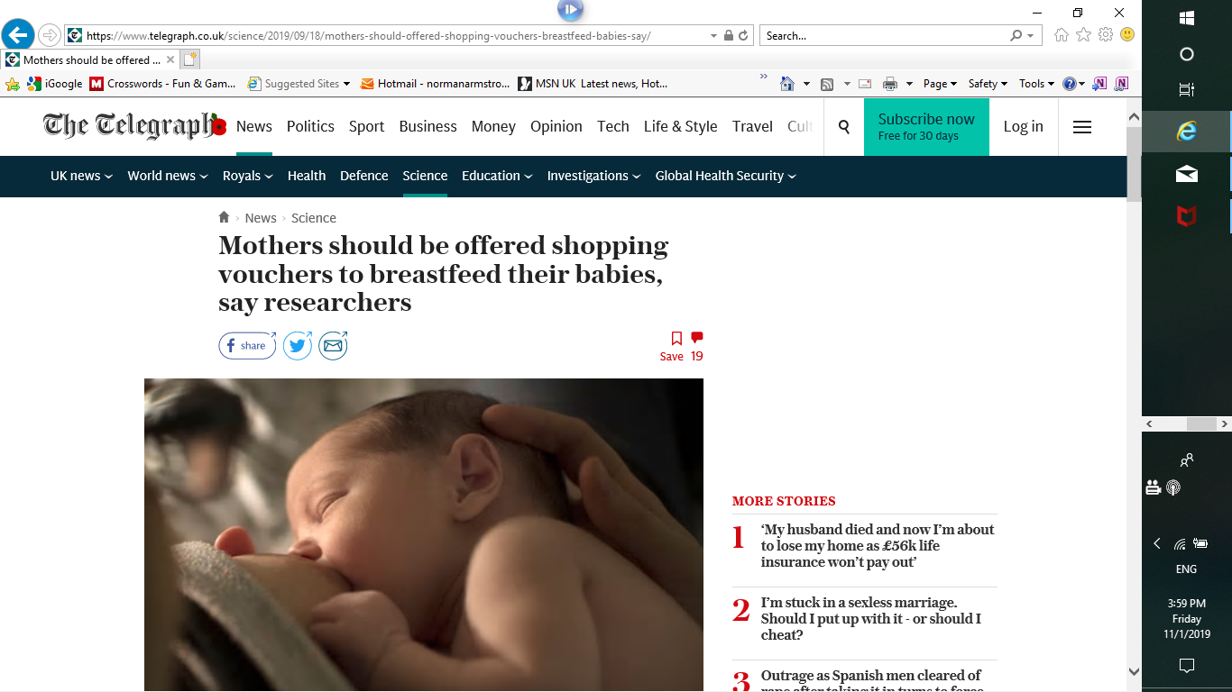
The Telegraph 18 September 2019

Slide 13
Research Summary
Cost-effectiveness analysis of the RCT in the North of England where a financial incentive (over a 6-month period) was trialled.
10 more additional babies breast fed in the intervention wards (39 vs 29). The cost per additional baby breast fed at 6–8 weeks was £974.
Obtaining robust estimates of the life time costs and benefits of breast feeding is difficult due to the need to model outcomes far into the future.
More research is required facilitate the comparison of financial incentives for breast feeding with a wide range of other public health programmes and healthcare technologies.

Slide 14
UKRI News/Blogs/Database
Multiple funders and funding along the career pathway
ESRC, EPSRC, MRC
PhD, fellowship, research grant

Slide 15
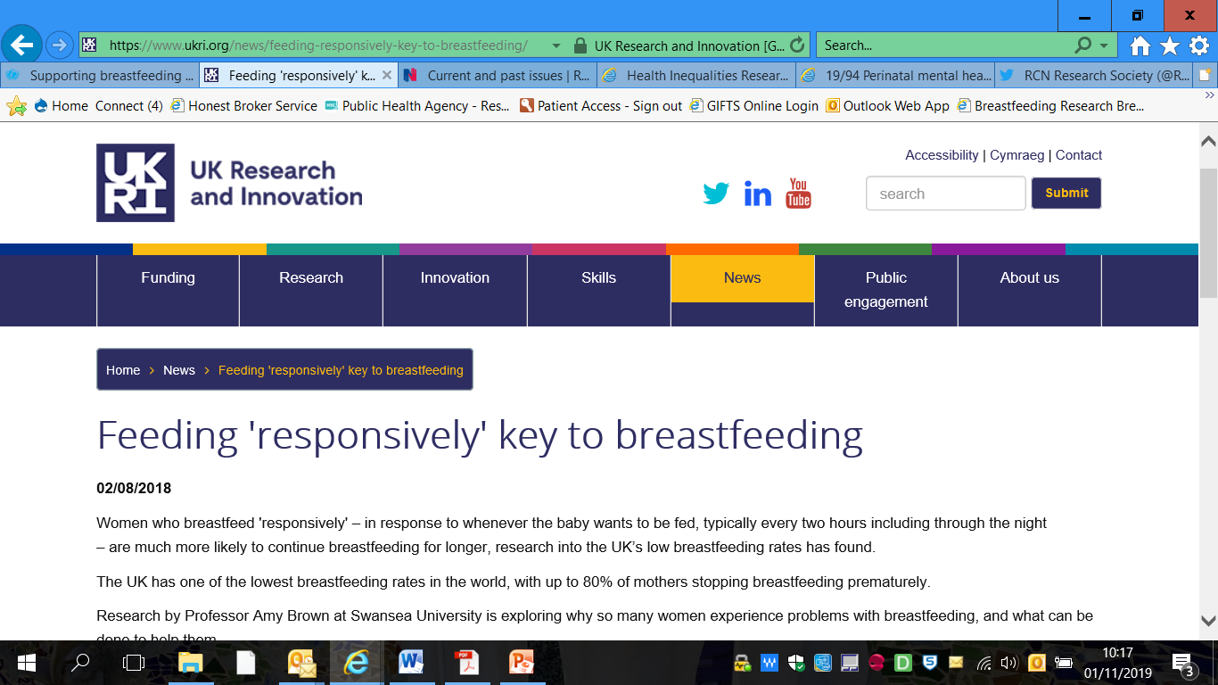
ESRC

Slide 16
Research Summary
Professor Amy Brown at Swansea University is exploring why so many women experience problems with breastfeeding, and what can be done to help them.
Main factor governing whether breastfeeding was successful or not was the feeding routine the mother adopted. Feeding ‘responsively’ led to a good milk supply and reduced the likelihood of pain, difficulty or poor weight gain.
Mothers that fed to a set routine were much more likely to experience breastfeeding difficulties, leading to them stopping breastfeeding.
Reasons for feeding to a set routine included worrying that a baby was feeding too often, as well as the belief that a baby should be established in a set routine and sleep through the night from an early age. This belief was also tied into wider pressures on women to ‘get their lives back’ and return to work, lose weight and socialise.

Slide 17
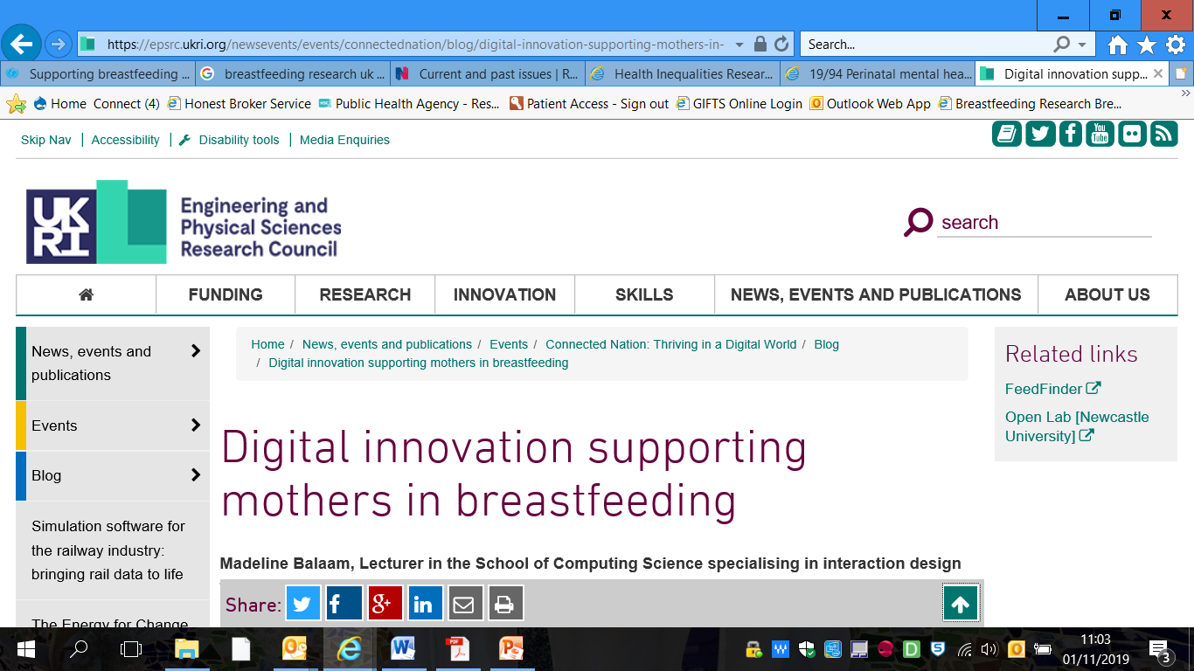
EPSRC

Slide 18
Research Summary
Dr Madeline Balaam, Lecturer in the School of Computing Science, Newcastle University
FeedFinder is a mobile phone app that supports women in finding, reviewing and sharing places for public breastfeeding.
Works in the same way as Trip Advisor, encouraging women to leave reviews for places where they have breastfed, as well as add new venues when they breastfeed somewhere that isn’t already listed.
It is free to download with over 4,000 users, who have mapped and reviewed over 2000 locations in the UK. Adoption in the North East has been good, with the region currently listing 325 venues and 551 reviews.
Several NHS Trusts now use and recommend FeedFinder to new mothers as part of their community midwifery service.

Slide 19
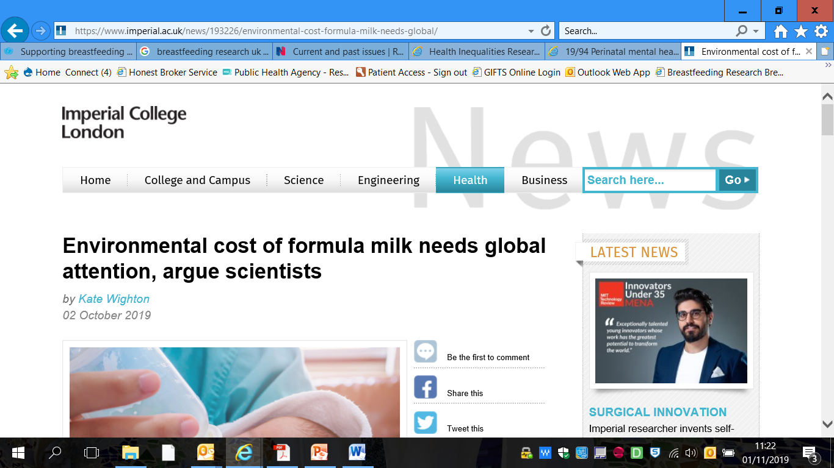
UKRI Future Leaders Fellow

Slide 20
Research Summary
The production of unnecessary infant and toddler formulas exacerbates environmental damage and should be a matter of increasing global concern.
Dr Natalie Shenker, UKRI Future Leaders Fellow at Imperial College London, and colleagues highlight research showing breastfeeding for six months saves an estimated 95-153 kg CO₂ equivalent per baby compared with formula feeding.
For the UK , carbon emission savings gained by supporting mothers to breastfeed would equate to taking between 50,000 and 77,500 cars off the road each year.

Slide 21
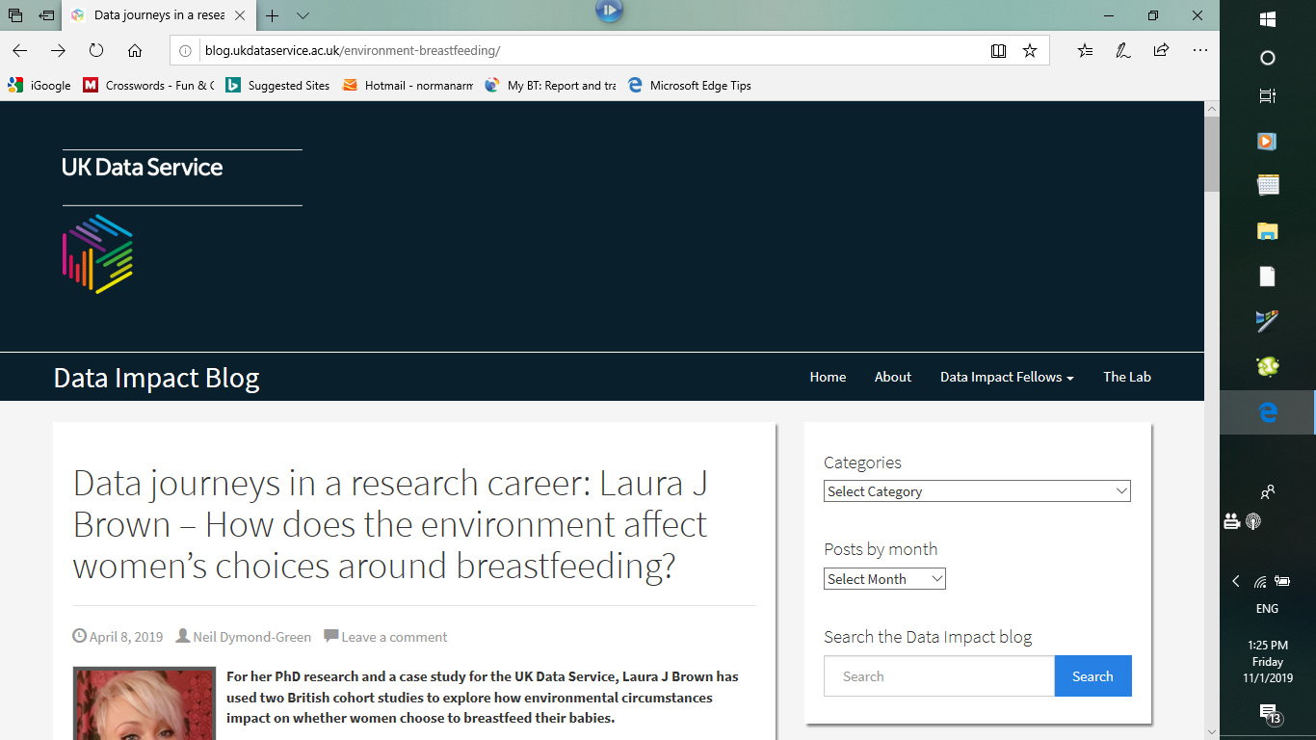
ERSC

Slide 22
Research Summary
Dr Laura Brown’s PhD examined environmental links in 2 UK cohort studies – The Millenium Cohort Study and the Born in Bradford study.
The findings support a shift in focus away from individual factors and towards altering the landscape of women’s decision-making contexts when considering behaviours relevant to public health.
White UK-born women are susceptible to adverse environmental exposures, they are perhaps lacking the sociocultural protection afforded by the cultural and religious affiliations of other ethnic groups.
Need to improve the support for women to breastfeed in public. Women who are brave enough to breastfeed in public are judged negatively. There is also a need to address the physical aspects of the environment to render it more supportive of healthful infant feeding practices.

Slide 23
UKRI

Slide 24
Research Summary
The UK has no dedicated centre of research into human milk, and few centres in the world focus on the maternal health impact of breastfeeding. An innovative programme of 3 research projects will be undertaken by Dr Natalie Shenker :
1. Provision of evidence of early changes in normal breast cells and provide important insights into how these increase risk of cancer. This work will provide the evidence needed to create a large study of human milk to develop new cancer screening tests.
2. The WHO recommends children are breastfed for at least 2 years, but only tiny amounts of data exists on the composition of human milk beyond 6 months. This study will profile each sample for the 1000s of fatty acids to understand how milk composition changes, if at all.
3. Late preterm babies have a lower chance of establishing breastfeeding. Late preterm babies will be randomised to receive donor milk compared to formula with lactation support to assess whether this helps mothers to establish breastfeeding.

Slide 25
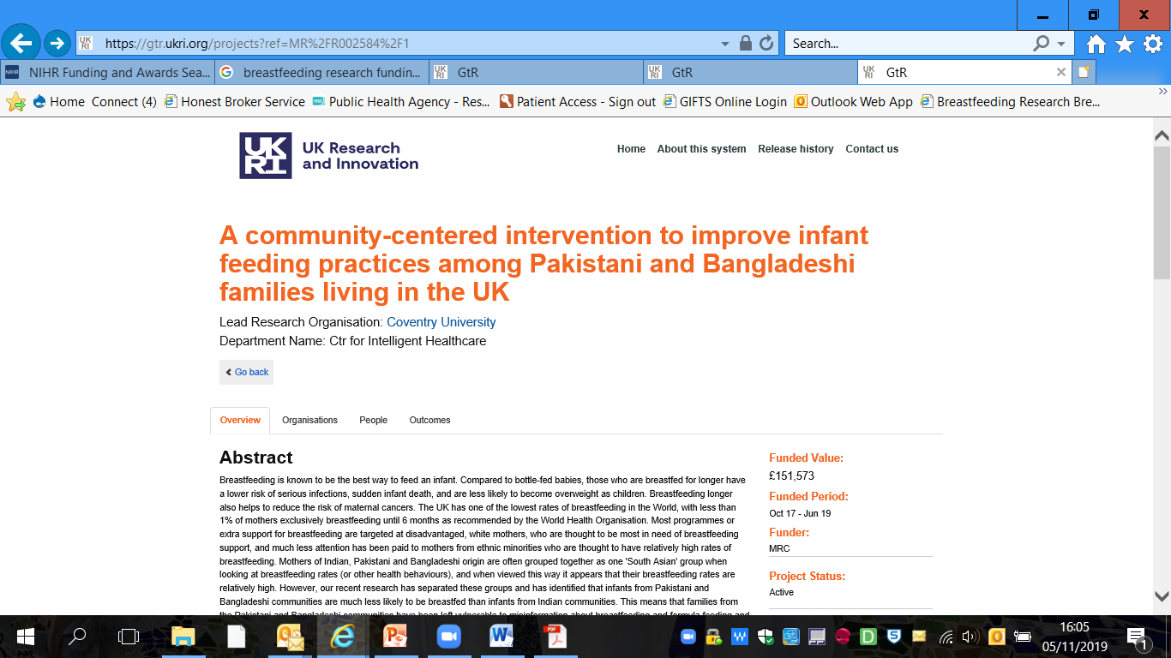
MRC

Slide 26
Research Summary
Pakistani and Bangladeshi communities living in the UK may be more vulnerable to lower breastfeeding rates than previously thought.
Dr Naomi Bartle of Coventry University aims to develop a novel, culturally specific and acceptable intervention to promote optimal infant feeding practices amongst the women in these communities.
To enable community and healthcare practitioners to provide culturally sensitive and evidence based information and support to families about infant feeding and to facilitate behaviour change within the communities.
To describe and disseminate the intervention so that community or health practitioners could apply the methodology to other communities in their local areas.

Slide 27
Closing Thoughts
There is a lot of research being undertaken
It is getting media attention
There are a lot of different types of research funded by many different funders
There are a lot of online tools to help find the research and who is leading it
There has never been a more exciting time to get involved in research as there is increasing emphasis on early childhood experience and life outcomes
Enjoy the day and make the most of the knowledge and expertise here today to make connections and to get actively involved in research and shaping the research agenda

