Slide 1
Implementing research in the community
Seána Talbot
Saol Úr Sure Start

Slide 2
Evidence based practice?
Notes:
Sure Start and NCT
Skype based support in Scotland, including isle of Skye

Slide 3
Saol Úr Sure Start
Whiterock, Upper Springfield, Falls Park
WR (Ballymurphy) most deprived health (5th education, 9th employment)
% of births to parents of low/medium social class (NINIS 2015)

Slide 4
Context
Mothers living in the 20% least deprived wards in Northern Ireland are around twice as likely to breastfeed as those mothers living in the 20% most deprived wards (59.6% vs 33.0%) (CHS 2014p).
The rate of breastfeeding at discharge from hospital was higher among mothers resident in Non Sure Start areas (51.6%) compared to mothers resident in Sure Start Areas (37.6%) (CHS 2014p).
Variation exists in the rate of breastfeeding at discharge from hospital recorded for Sure Start areas in Child Care Partnership areas e.g. in the Belfast area the highest rate of breastfeeding at discharge was recorded for South Belfast Sure Start (51.7%) compared to the lowest for Saol Ur (18.8%) (CHS 2014p).

Slide 5
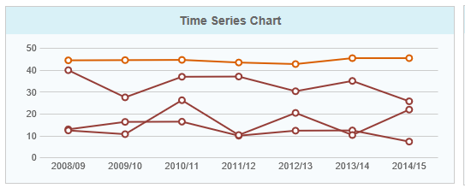
Percentage Mums breastfeeding on discharge www.cypsp.org

Slide 6
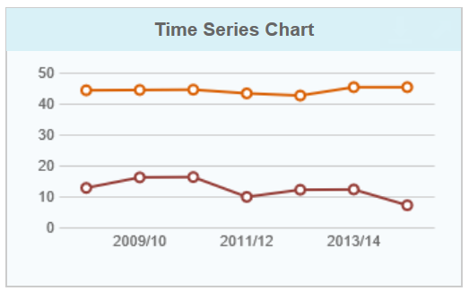
Percentage Mums breastfeeding on discharge
_____ NI
_____ Whiterock

Slide 7
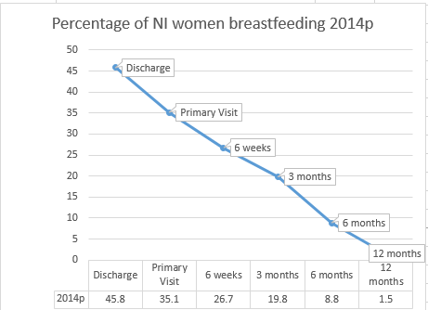
Duration
CHS data on breastfeeding duration shows a drop in the number of infants receiving any breast milk, from:
45.8% at discharge to
35.1% at the primary visit,
26.7% at 6 weeks,
19.8% at 3 months,
8.8% at 6 months and
1.5% at 12 months (CHS 2014p).

Slide 8
NI data – adjusted n=11,450 (based on 45.8% of 25k)
27% at six weeks = 6, 750
= 59% of bf babies
43% at 3 months,
20% at 6 months and
2% at 12 months (CHS 2014p).

Slide 9
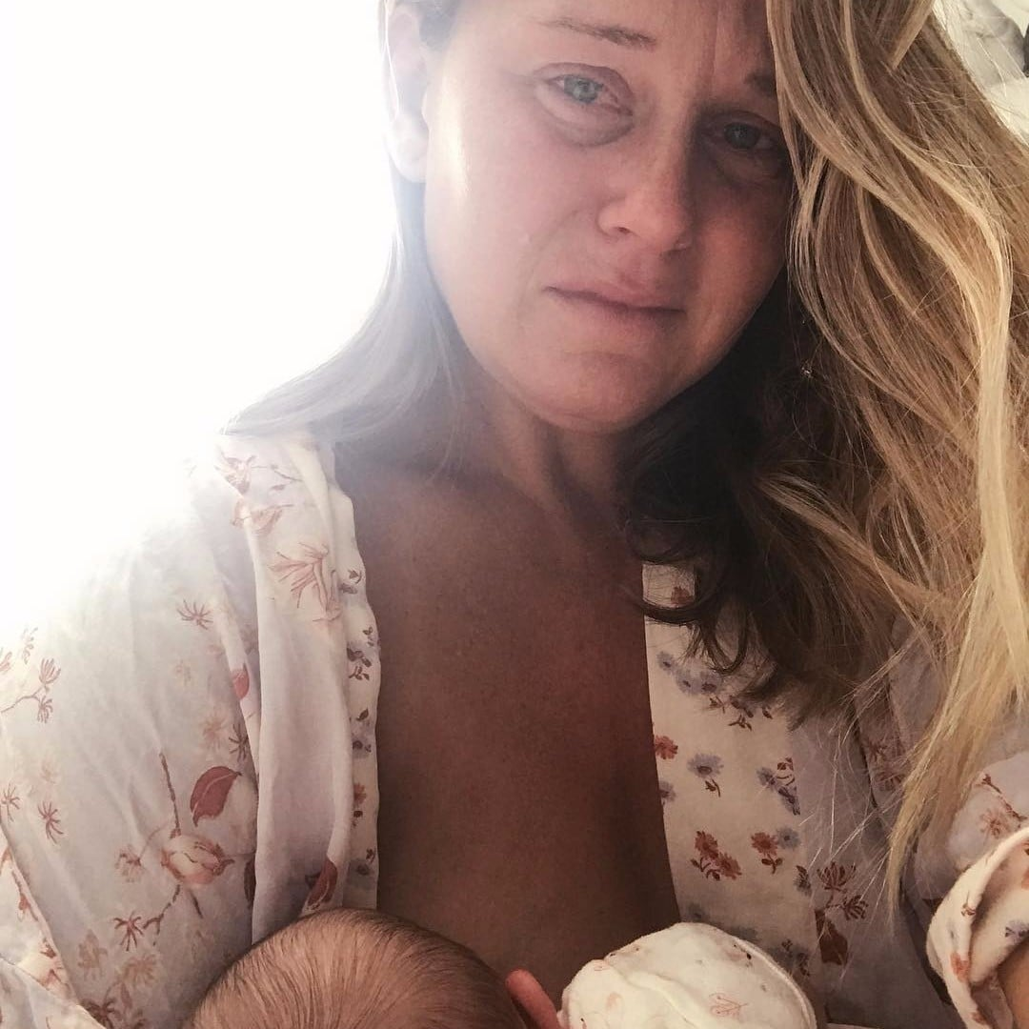
Supporting breastfeeding
Self efficacy
Breaking down barriers
Cultural beliefs
Accurate, consistent information
Support
Peer support
Access to specialist support
NOSH Vouchers
Women stopping before they want to
Relationship-based support
Notes:
one brave new mom has shared some refreshingly honest selfies that show that the reality of breastfeeding can look a lot different than the idealized image.
In honor of National Breastfeeding Week, mom and photographer Angela Burzo shared a tearstained photo of herself attempting to breastfeed with a harsh dose of reality: Breastfeeding is beautiful and natural and easy—and often it is not.

Slide 10
Saol Úr breastfeeding support
Midwife 30h
Not a specialist
RJMS 3 LCs
Relationships
Reactive support

Slide 11
Saol Úr breastfeeding support
Midwife 30h
Lactation consultant 20h (LLL)
Antenatal teacher 20h (NCT)
Build relationships antenatally
Proactive support
Aim – increase duration by providing
specialist wraparound support

Slide 12
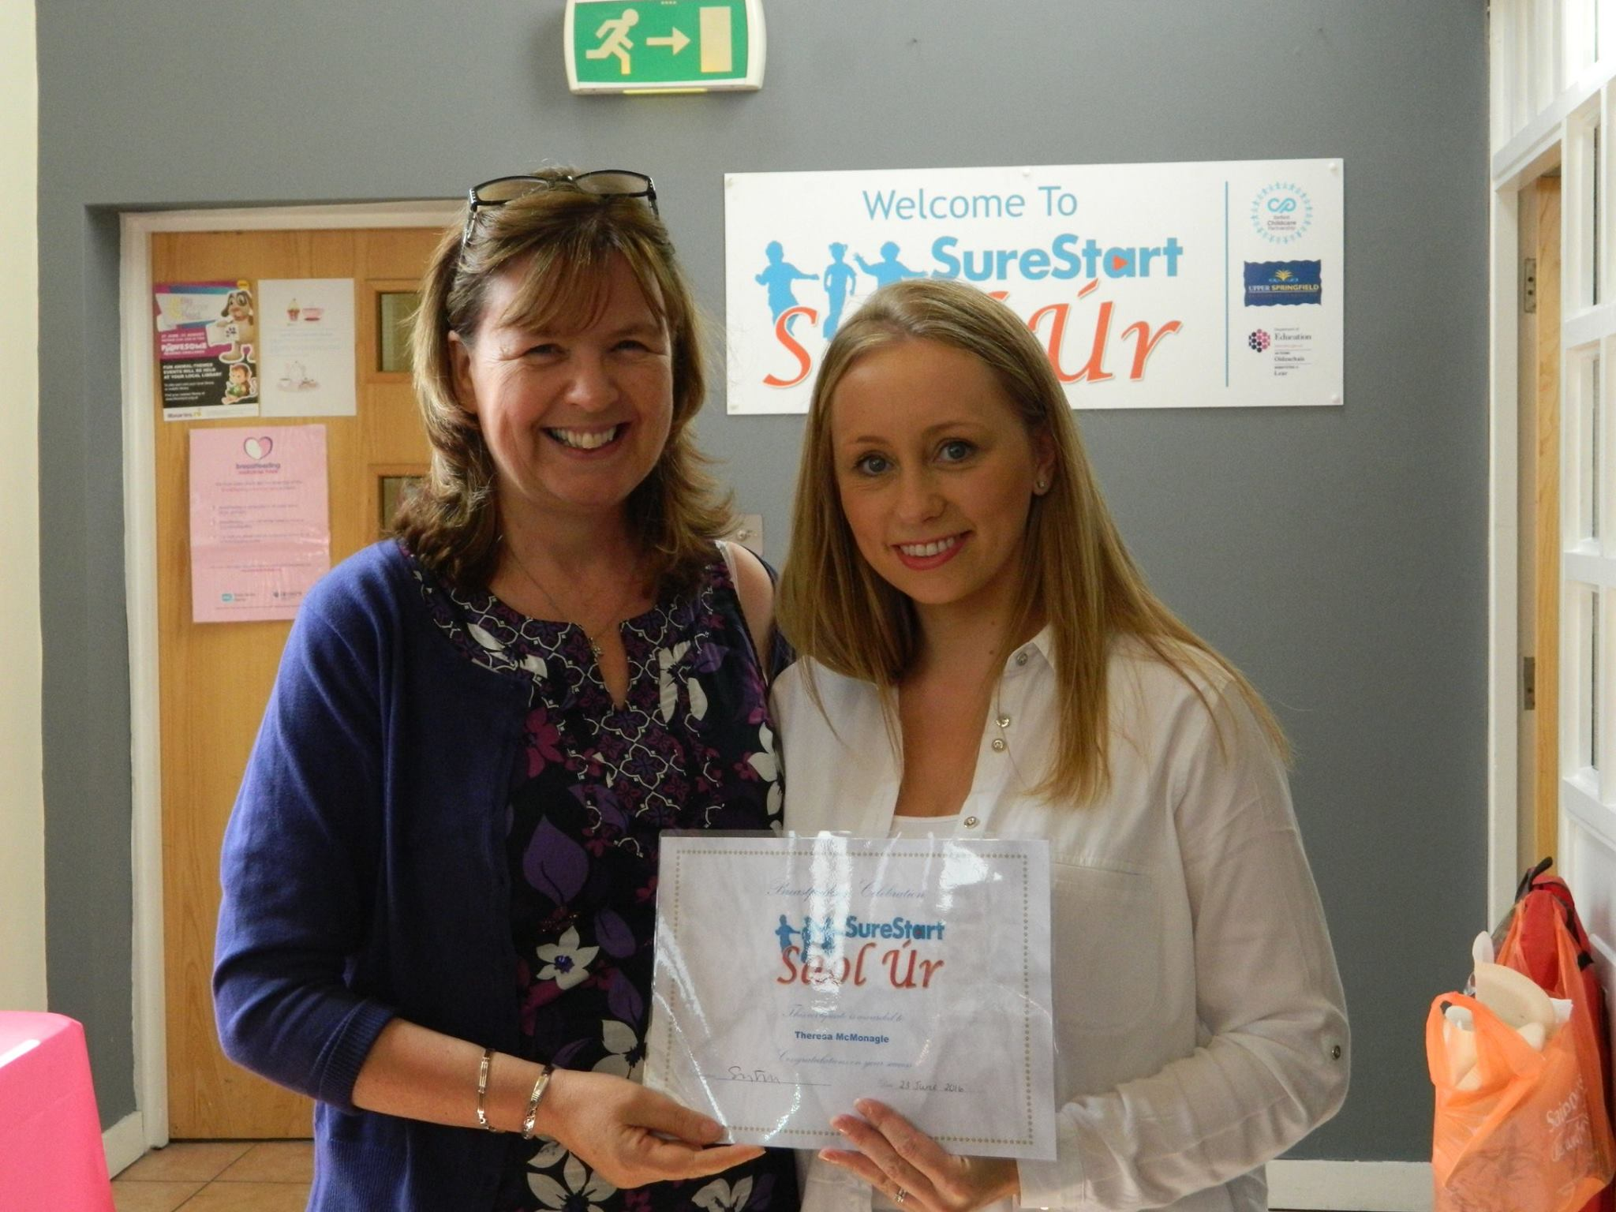
Babies born in 2016
2016 - 32 bf women
(approx. 13% of all local births)
(NI= 20% of bf babies still bf at six months)

Slide 13
Babies born in 2016

Slide 14
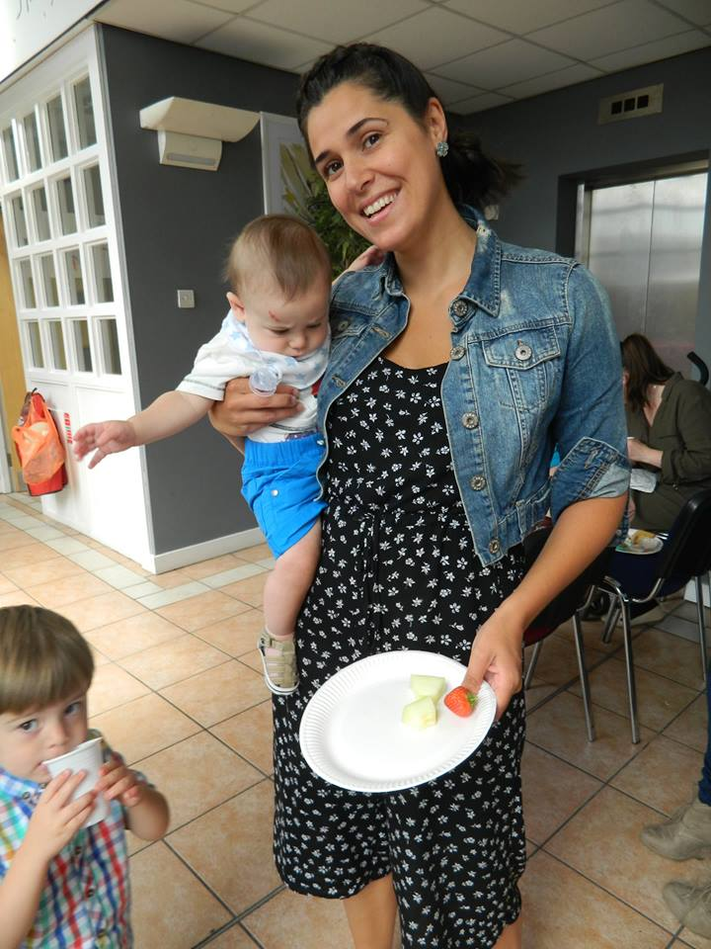
Caveats - 2016
Normal clustering
Friendship group
Falls Park

Slide 15
Babies born in 2017
37 women
More fluid group
Mix – from all three wards
13 FP
9 WR
11 US

Slide 16
2017

Slide 18
Babies born in 2018
Midwife role changed
Vacancy
24 women
15 Whiterock
8 short-term (6+2)
‘Didn’t like it’
Only 3 or 4 ABC1
Vouchers
Notes:
5 US
4FP

Slide 19
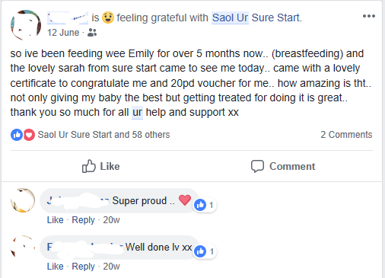
2018 - vouchers
£20
Two weeks
Six weeks
Four months
Sometimes late
Not promoted beforehand
Framed as a ‘thank you’

Slide 20
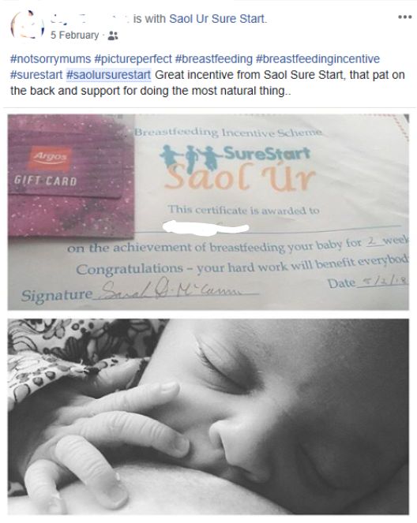
2018 - vouchers
£20
Two weeks
Six weeks
Four months
Sometimes late
Not promoted beforehand
Framed as a ‘thank you’

