Slide 1
Antiepileptic drugs (AEDs) - Salivary testing of infants with breastmilk exposure and the decision-making processes of women with epilepsy regarding infant feeding
Supervisory Team: Professor Marlene Sinclair Dr Bernadette Reid Dr Bridgeen Callan
Laura Hutchinson PhD 10th November 2017
Notes:
Hello everyone, my name is Laura Hutchinson, I am a pharmacist and am working within the School of Nursing and School of Pharmacy here at Ulster.
My study is looking at:

Slide 2
Background
There are roughly 150 women annually in NI who have epilepsy and give birth
These women cannot stop their AEDs
The information available for women with epilepsy and their healthcare professionals is limited and often conflicting in the area of medication transfer and infant feeding

Slide 3
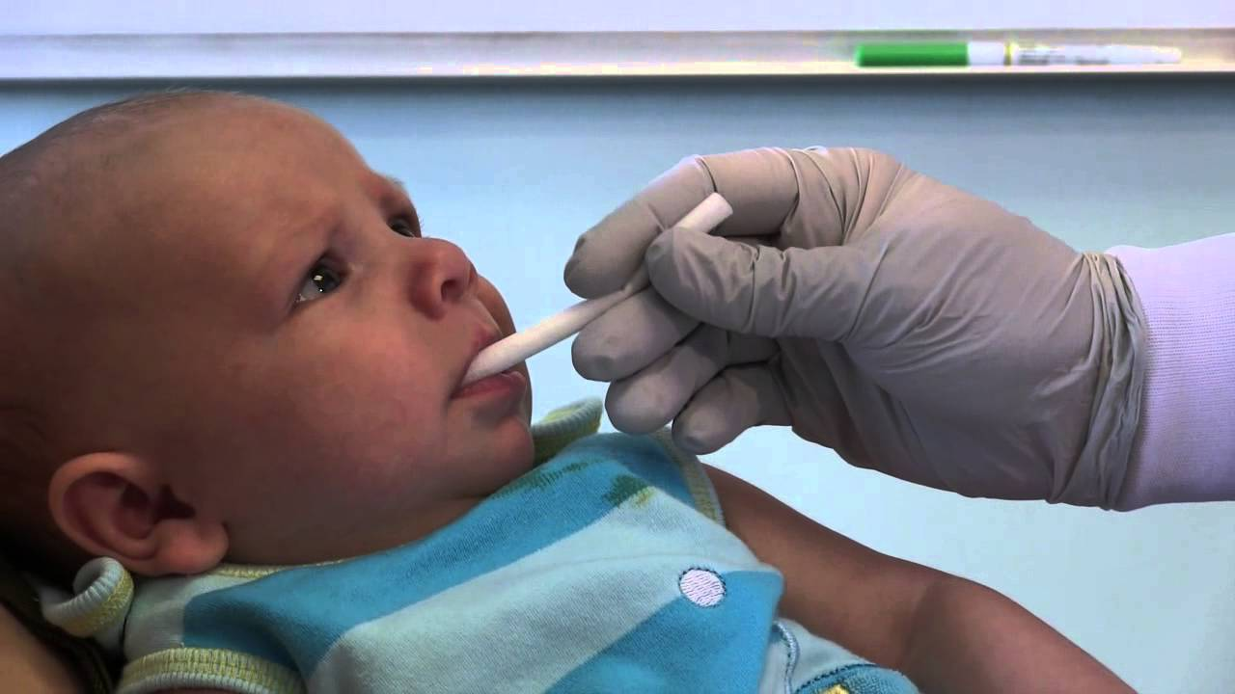
Why are we studying this?
Saliva testing of breastfed infants in this area has never been studied
The decision making processes of these women regarding infant feeding has also never been studied before
Notes:
Saliva therapeutic drug monitoring has been completed accurately in adults, children and infants, but never breastfed infants whose mothers are taking antiepileptic drugs
Decision making around infant feeding has been studied in the general population, but never specifically aimed at women who are taking antiepileptic medication.
So the process will involve 3 interviews with the women and the saliva and breastmilk testing is shown.

Slide 4
Potential solutions
This research will determine the feasibility of using saliva therapeutic drug monitoring in infants whose mothers are taking AEDs
It will also give an insight into the factors which influence women on AEDs in their infant feeding choices

Slide 5
Progress to date
First literature review published
Second is ongoing
19 participants have been interviewed about their decision making
10 sets of samples have been collected
4 have been breastfed
3 babies due in November 2018, 2 of which hope to breastfeed

Slide 6
